Slide 1
INAF IN CTA: Il progetto ASTRI
Bruno Sacco
IASF-Palermo/INAF

Slide 2
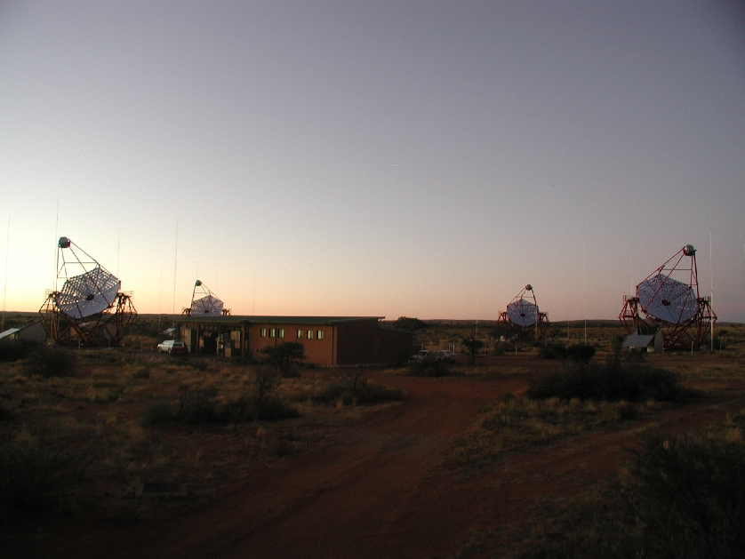
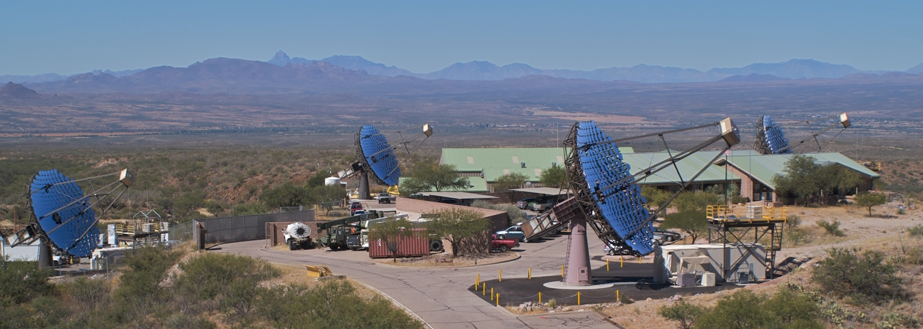
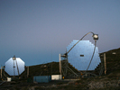
HESS, (4*12m) telescopes, Namibia
VERITAS, Arizona
MAGIC (2*17m) telescopes , La Palma
Canary Islands
 | WIPPLE | HESS | MAGIC | VERITAS
Site | Arizona | Namibia | Canary Island | Arizona
Lat (°) | 32 | -25 | 29 | 32
Alt (km) | 1.3 | 1.8 | 2.2 | 1.3
Tel. Ǿ (m) | 10 | 12 | 17 | 12
N. Tel. | 1 | 4 | 2 | 4
FoV Ǿ (°) | 2.3 | 5 | 3 | 3.5
Thresh. (GeV) | 300 | 100 | 50 | 100
Sensitivity (mCrab) | 150 | 7 | 20 | 10

Slide 3
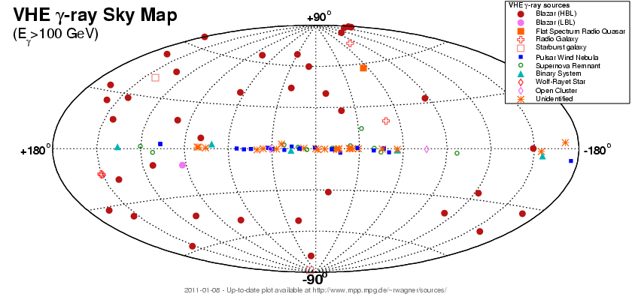
2011
http://www.mppmu.mpg.de/~rwagner/sources/
R.Wagner, VHE γ-ray Sky Map and Source Catalog > 100 Sources
B.Sacco relazione al MeraTeV , Merate 4-6 ottobre, 2011

Slide 4
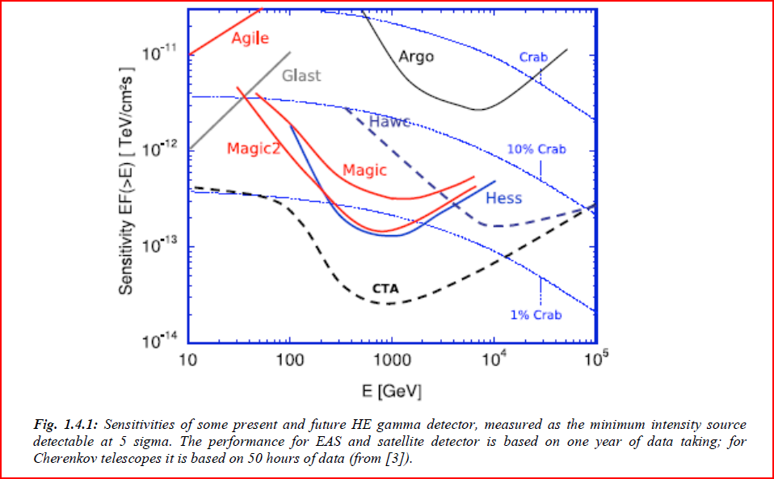
Gain one order of magnitude in sensitivity at 1 TeV (1mCrab), more and more sources
Reach 10-20 GeV in lower energy threshold: Space mission upper threshold
FUTURE !
Reach 100-200 TeV in upper energy threshold:acceleration processes and Cosmic Ray paradigma
Improve angular resolution (< 1 arc-minute) : extensive sources, unidentified sources.
Increase the FoV (2-4 ° ==> 8-10°): trigger efficiency for high energy events, surveys

Slide 5
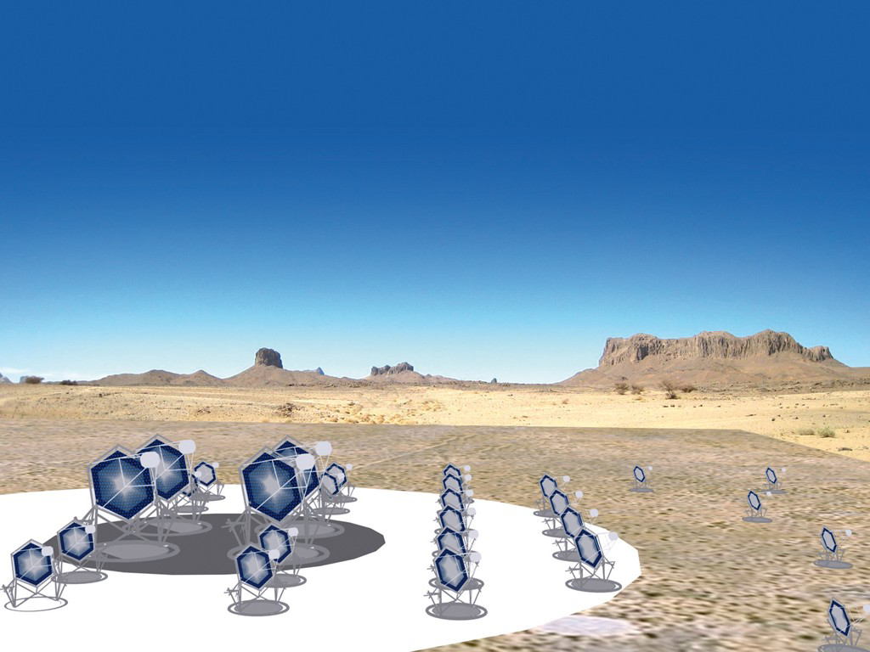
Cherenkov Telescope Array
n1 LST: 24 m telescopes for the low energy (E > 0.01 TeV)
n2 MST: 12 m telescopes for the medium energy (E > 0.1 TeV)
n3 SST: 4/7 m telescopes for the high energy (E > 10 TeV)
> 60 The telescopes will be spread in > 2*2 km square
Artists view of a possible CTA configuration, with three different telescopes types covering the overlapping energy ranges, and area coverage which increases with increasing gamma-ray
energy. ( from the CTA –PP, Preparatory Phase)

Slide 7
CTA construction costs for 2 sites = > 200 Meuro, rough order of magnitude
CTA Consortium is composed by more than 100 scientific Institutes belonging to 23 countries :
14 from European Union (Bulgaria, Czech Republic, Denmark, Finland, France, Germany, Greece, Italy, Ireland, Holland, Poland, Spain,Sweden and UK), 3 European (Armenia, Croatia and Switzerland) and 6 extra-european (Argentine, Brasil, Japan, Namibia, South Africa e USA). Participations in fieri: India, Slovenia
2008 : CTA is in the roadmap of the European Strategy Forum on Research and Infrastructure (ESFRI).
2009: CTA has been evaluated by ASPERA as one of the seven most important European projects for the Astro-particle physics.
2010: The Preparatory Phase for the Cherenkov Telescope Array (October 1, 2010 – September 30, 2013) is funded by CE in the framework of the FP7-INFRASTRUCTURES-2010-1 call for 5.2 Meuro
2013/2014: Start of the CTA construction

Slide 9
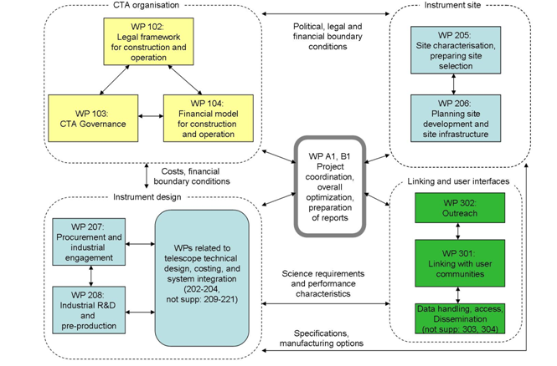
PREPARATORY PHASE

Slide 10
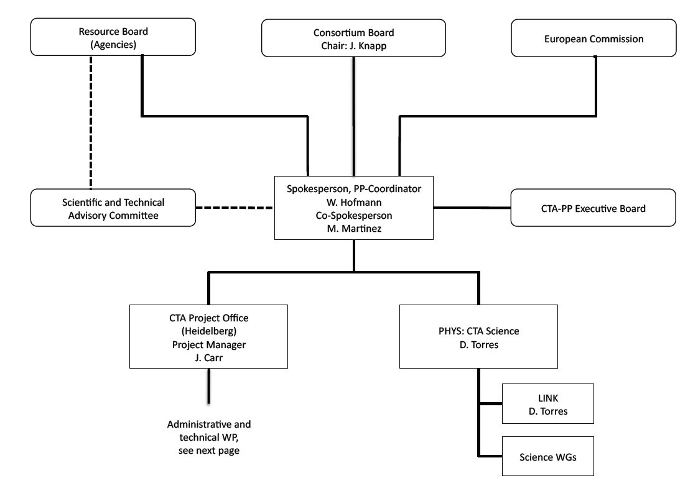

Slide 11
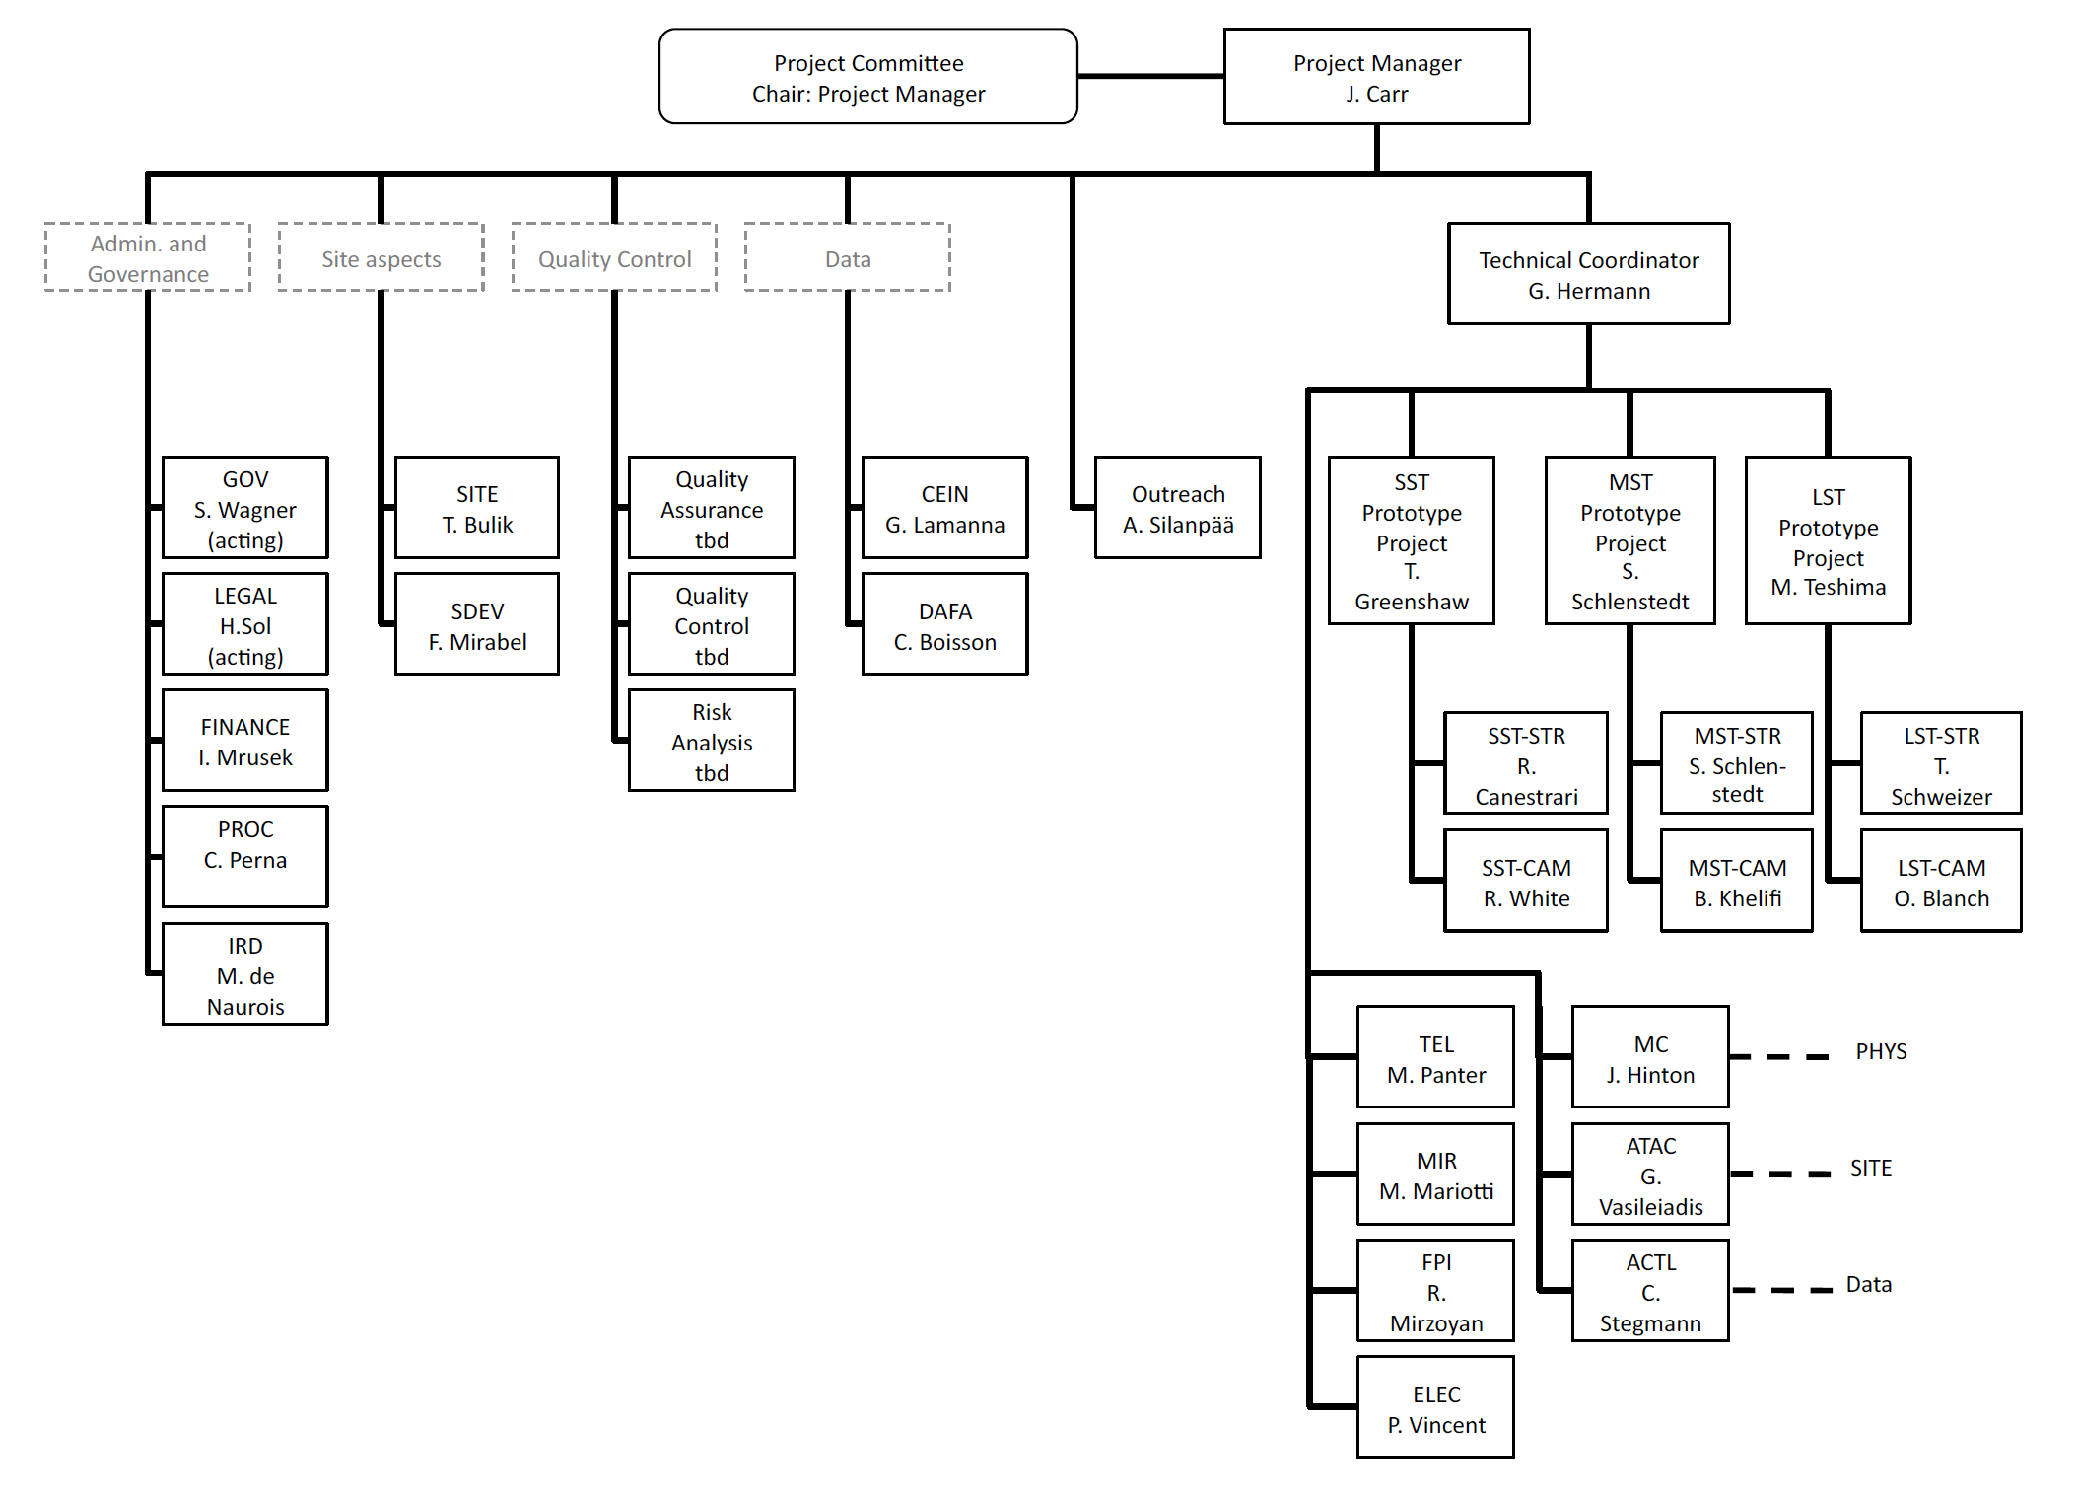
G. Pareschi

Slide 12
Italian participation to CTA:
INAF + University of Padova (Siena, Udine)
INAF ====➔ 56 (Scientists, Engineers, Technicians) (24 FTE)
Dip.Progetti, IFSI-To, OAB, IASF-Mi, OAPd, OATs, OABo, OARm, IASF-Rm, IASF-Pa, OACt + OANa, TNG
Within the CTA_PP
INAF has representative members in:
Resource Board , General Board, Executive Board, Technical Committee
INAF is responsible for the CTA_PP Procurement (C. Perna)
INAF is responsible for the SST Mirror&Structure (G. Pareschi)
INAF participates to several CTA_PP activities:
Science, Mirrors, Telescope Structures, MC, Data Handling, SST camera sensors and electronics, SST dual/single mirror choice

Slide 13
ASTRI
( Astrofisica con Specchi a Tecnologia Replicante Italiana)
R&D program financied by MIUR
In the spring 2010 INAF submitted to the Italian Ministry of Reaserch the ASTRI project,
where has been requested a financial support (8Meuro) for a three years program (2011-2013) to develop technologies for the CTA : Mirrors (with replica tecnique) , sensors and electronics for the telescope cameras
ASTRI has been approved as one of the, so called, “Progetti Bandiera “and INAF received 3Meuro in 2011.

Slide 14
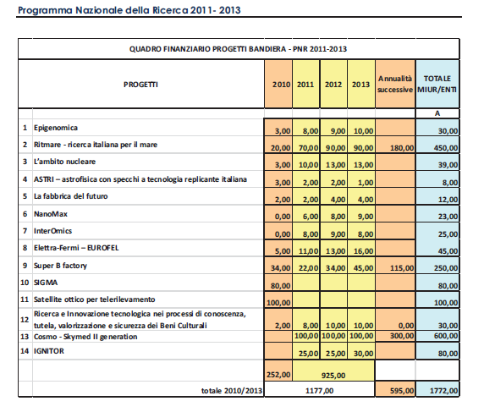

Slide 15
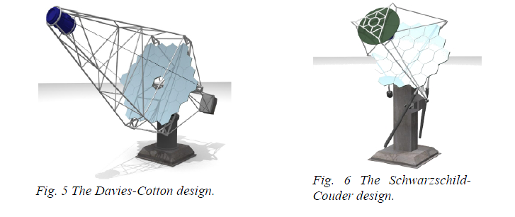
Single mirror DC is the optical model of the present Cherenkov telescopes
Single mirror DC is the baseline for LST and MST of CTA.
Dual mirror SC, originally proposed by the american AGIS group , in the CTA is now in competition with DC for SST and it is also studied as alternaitve solution for MST.

Slide 16
Output of ASTRI

Slide 17
ASTRI: Astrofisica con Specchi a Tecnologia Replicante Italiana | Consum. /contracts | Travel | Personnel | Lab. Instr | Over head | total
Project Management | 10 | 5 |  |  |  | 15
Dual mirror-SST End to End Prototype | 1030 | 87 | 590 | 250 |  | 1957
Single mirror-SST Structure | 200 | 9 | “”” | 50 |  | 259
SST+MST Mirrors | 260 | 9 | “”” |  |  | 269
Ancillary activities
Science | 10 | 9 | 100 |  |  | 119
M.C. simulation | 9 | 5 | 50 |  |  | 64
Observatory & data hand. | 9 | 7 | 50 |  |  | 66
Industrial Procurement | 12 | 9 | 50 |  |  | 71
INAF Overhead |  |  |  |  | 180 | 180
total | 1540 | 140 | 840 | 300 | 180 | 3000

Slide 18
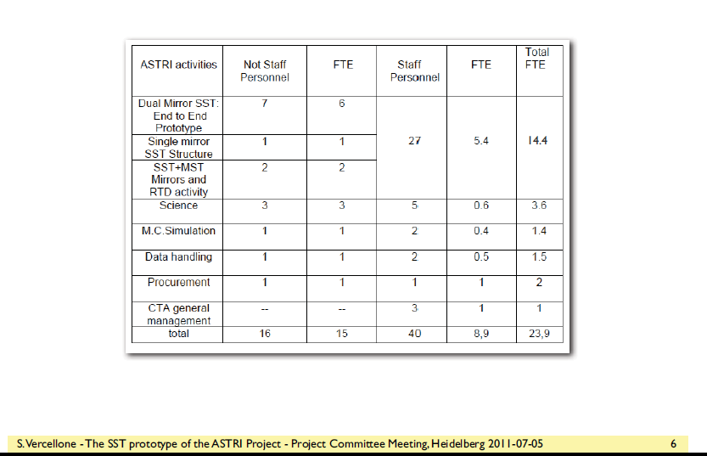

Slide 30
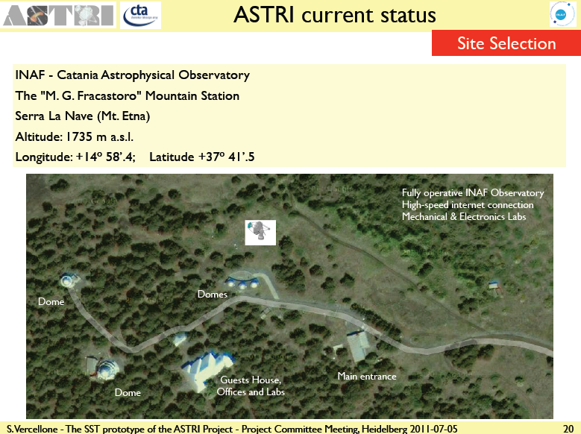

Slide 32
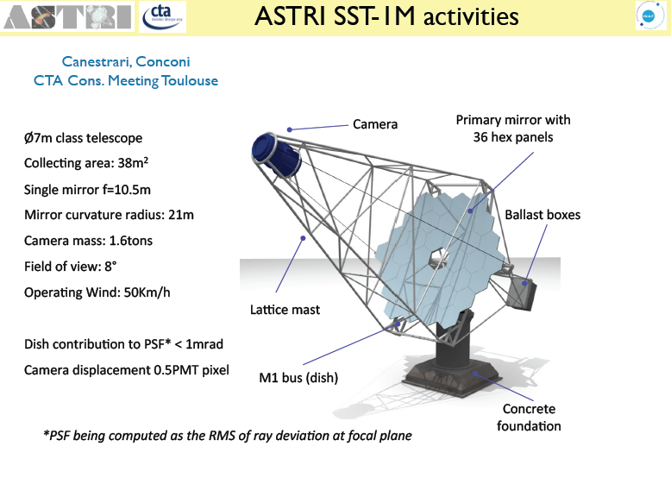

Slide 34
ASTRI gives support to other activities
Science: contribution to CTA science
& scientific performance of the SST prototype
MC Simulation: contribution to CTA MC
& specific activities for the SST prototype
Data Handling: contribution to CTA specific wps
Site: contribution to CTA sites specific wp

Slide 35
Conclusions:
CTA is a project of a large array of Cherenkov telescopes for TeV astronomy.
CTA is in the Preparatory Phase funded by the European Commission
(October 2010- Sep. 2013).
CTA will be located in two sites (southern and nothern emispheres).
CTA is well supported at International level and it has good chances to be realized.
CTA construction will start in 2013/2014
CTA will be operated as an observatory on the base of the scientific merit
INAF is funded by EC for the preparatory phase
INAF has a major role in the CTA and it is present in the relevant boards
INAF is responsible for the CTA_PP Procurement and for the SST structure&mirrors
INAF participates to several CTA_PP activities (Science, Mirrors, Telescope Structures,
MC, Data Hand., Obs. definition)
In the framework of the program ASTRI funded by the Italian Ministry of Research :
INAF plans to build an end_to_end prototype of the Dual Mirror SST
INAF will contribute to the mirrors and structure of the Single Mirror SST prototype
INAF will contribute to the mirrors for MST prototype
INAF will support the CTA activity ancillary to the ASTRI program

