Slide 1
Cherenkov Telescope Array CTA
Massimo Persic
INAF+INFN Trieste
for CTA Consortium
Merate, Oct 6, 2011

Slide 2
Outline
Ground-Based gamma-ray astronomy
Physics questions left by the current instruments
The Cherenkov Telescope Array
Sensitivity Requirements
Current Status & Design Study, e.g.
Example MC simulation
Location Studies
Possible Schedule
CTA in Context
Conclusions
With slides from:
A.DeAngelis, G.Hermann, J.Hinton, W.Hofmann, M.Martinez, S.Nolan, S.Ritz, Th.Schweizer, M.Teshima, D.Torres

Slide 3
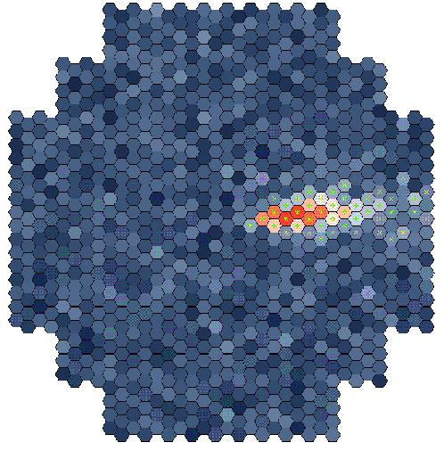
Potentially 5 decades of energy accessible via this technique (~few GeV to few hundreds of TeV)
1 decade of overlap with satellite experiments

Slide 4
Ground Based γ-ray Astronomy

Slide 5
γ-ray Astronomy from Ground

Slide 6
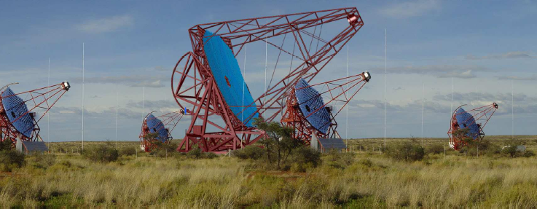
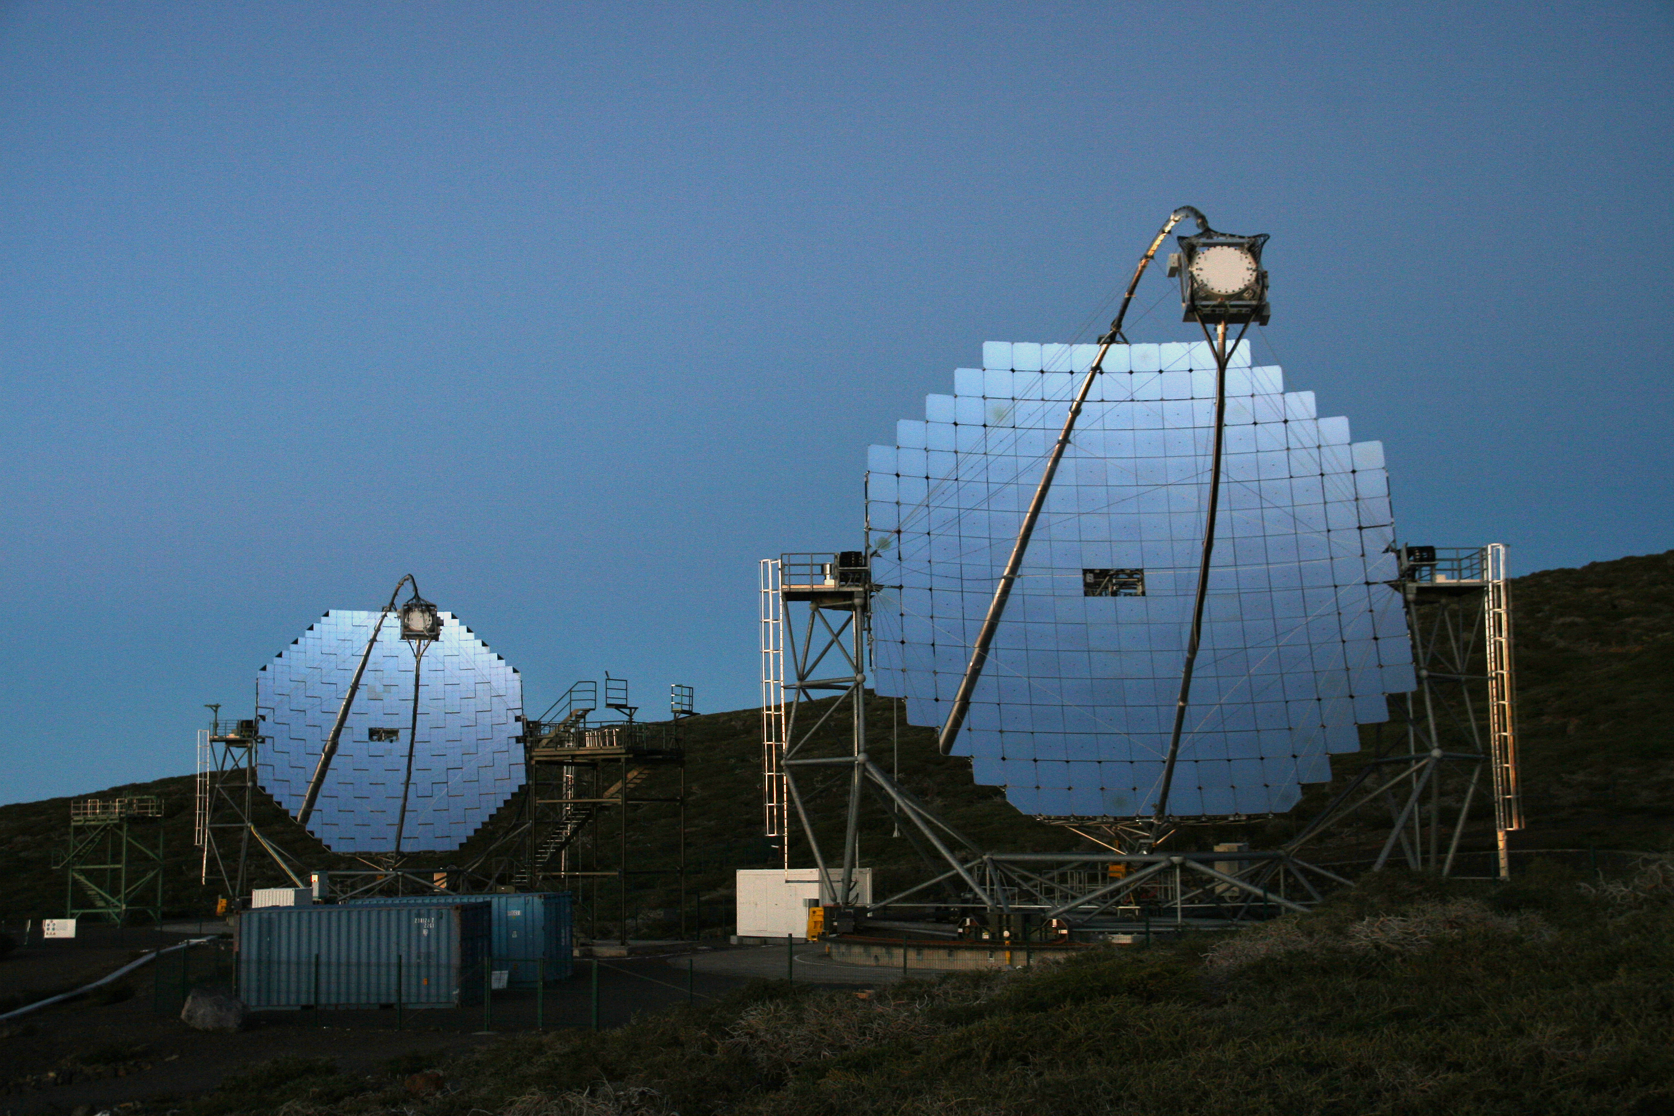
Ground Based γ-ray Astronomy
H.E.S.S. II (1st light 2012)
MAGIC II (1st light 2009)

Slide 7
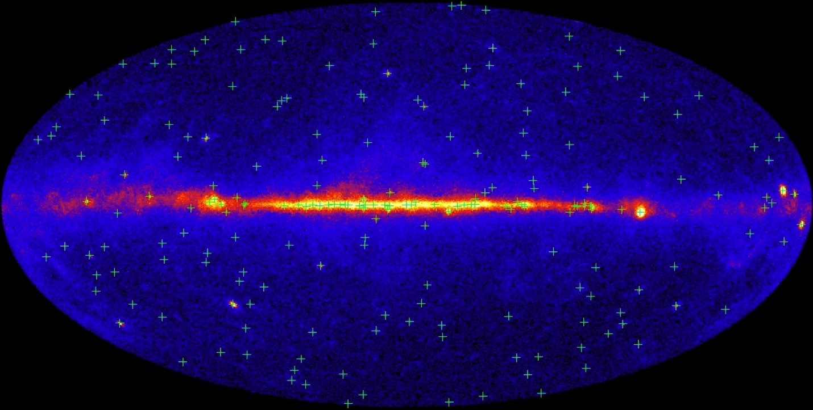
… and space (FERMI)
Green crosses indicate 205 brightest LAT sources
EGRET on the Compton Observatory found fewer than 30 sources above 10σ in its lifetime.
Typical 95% error radius is less than 10 arcmin. For the brightest sources, it is less than 3 arcmin. Improvements are expected.
About 1/3 of the sources show definite evidence of variability.
Over 40 sources have no obvious associations with known gamma-ray emitting classes of objects.

Slide 8
Current Status
The current generation of telescopes (H.E.S.S. / MAGIC / VERITAS) have detected >100 sources.
Several more with HESS2 / MAGIC2 / VERITAS
Stellar Winds
Supernova Remnants
Pulsar Wind Nebulae
Binary Systems
Molecular Clouds
Galactic Centre
No Counterpart/Dark Sources
AGN
Constraints on EBL
Constraints on QG
CR Electron Spectrum
Regular 70 GeV-20 TeV observations made with few % Crab sensitivity.

Slide 9
Science Potential
adapted by Hinton from
Horan & Weekes 2003
Distance kpc Mpc Gpc
Starbursts
Blazars
SNR/PWN
Radio Gal.
Binaries
Pulsed
Current
CTA
Sensitivity
Flux
Colliding
Winds
Clusters
GRBs
+Dark Matter
Current instruments have passed the critical sensitivity threshold and reveal a rich panorama, but this is clearly only the tip of the iceberg
What big science questions remain ?

Slide 10
Big Science Questions
Determine:
Origin of galactic cosmic-rays
Whether γ-ray binaries emit via wind/jet
Study:
Star formation regions
Pulsars and PWN
Studying Physics of AGN Jets
Constrain:
Extragalactic Background Light
Quantum Gravity Energy Scale
Discover:
WIMP annihilation
NT view of cosmological structure formation
Dark sources / New source classes

Slide 11
A few examples of science cases
for CTA …

Slide 12
Spectral modeling of SNRs ….
Spectral degeneracy at
TeV energies
HESS J1834-178
uuu
CTA
AGILE
GLAST
MAGIC
Hadronic: 2M⊗ of target gas, exp-cutoff proton distrib: α=2.1, E_{c}=100 TeV,
n_{p}=6cm⁻³, L(0.4−6 TeV)=2.5E+34erg/s
Leptonic: B=10mG, exp-cutoff electron distrib: α=2.0, E_{c}=20TeV
D = 4 kpc
low E_{thr} (~10-30 GeV)
to discriminate
VHE γ-rays:
hadronic or leptonic ?
CTA → improved low-E coverage, solve spectral degeneracy

Slide 13
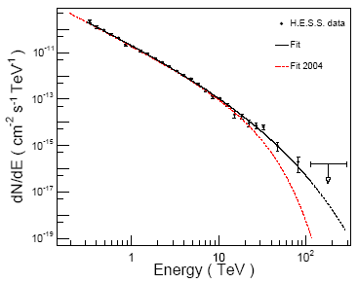
… and the origin of Galactic CRs
J1713.7-3946
Leptonic:
E_{e} ~ 20 (E_{γ} )^{1/2} TeV
~ 110 TeV … but KN sets on .. → ~100 TeV
Hadronic:
E_{p} ~ E_{γ} / 0.15 ~ 30 / 0.15 TeV ~
~ 200 TeV = 10^{5.3} GeV
Importance of improving statistics: 3 years of HESS data
1 year
CTA: improved statistics at E_{γ} > 100 TeV, to probe CR knee

Slide 14
Measurement of diffusion coefficient (cf. diffusion-loss equation)
Aharonian + 2006
• index Γ~2−2.2 (strong NR shock)
• little variation across SNR
CTA → spatially resolved spectroscopy
young SNRs (t<t_{cool} (p,e)):
CRp spectrum γ = 1+2α + b
→ measure κ(p) as a function of p
= p^{b} … b~0.6 ?
from secondary/primary
ratio
diffusion coefficient:
κ(p) ∝ A p^{b}
from VHE
from radio

Slide 15
Cosmic Rays and Star Formation
… more in general:
CR – SN relation
v Fermi-I mechanism → SNRs
v SN rates, massive star formation
γ-ray (direct)
Test:
U_{p} ~ ¼ (ν_{SN} τ₋) (η E_{ej}) r_{s}⁻³
radio (indirect)
→ field- particles
equipartition
70 GeV-20 TeV
observed
Milky Way
normalization
observed
Arp 220 → U_{p} ≈ 475 eV cm⁻³
NGC 253 → 125
M 82 → 110
Milky Way → 1
M31 → 0.3
LMC → 0.2
SMC → 0.1
Early gals.:
→ high U_{p}
→ Gas heating
→ M_{jeans} affected?
CTA: more SF gals
to be discovered ..

Slide 16
Gamma-Ray Bursts (GRBs)
• Most energetic explosions since Big Bang (10⁵⁴ erg if isotropic)
• Astrophysical setting unknown (hypernova?)
• Emission mechanism unknown (hadronic vs leptonic, beaming,
size of emitting region, role of environment, … … )
Cosmological distances (z >> 1)
→ Missed naked-eye GRB 080319B (z=0.937)
----------------------------------------
MAGIC
CTA → low E_{thr} ~ 20 GeV
to see GRBs !!

Slide 17
GRBs
080319B → missed obs of “naked-eye” GRB
Intrinsically:
Nearby: z=0.937
Brightest ever observed in optical
Exceedingly high isotropic-equivalent in soft γ-rays
Swift/BAT could have observed it out to z=4.9
1m-class telescope could observe out to z=17
Missed by both AGILE (Earth screening) and MAGIC (almost dawn)
next BIG ONE awaited !!

Slide 18
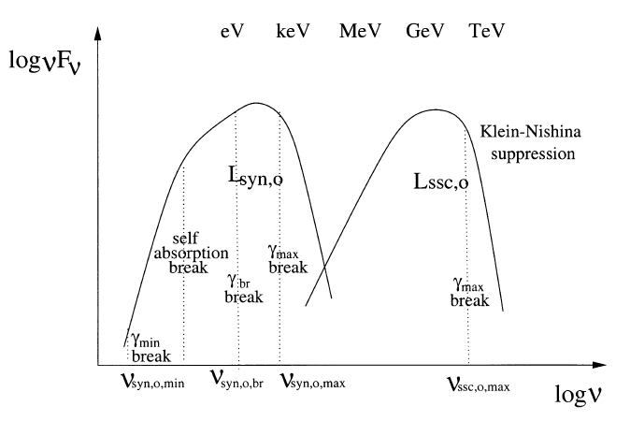
AGN
Quiescent states of low/intermediate-z blazars
High states of high-z blazar
IACT
CTA

Slide 19
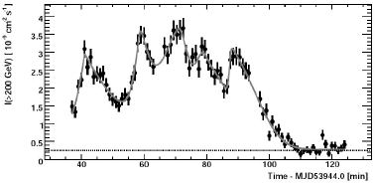
PKS 2155-304
(H.E.S.S.)

Slide 21
Probing Quantum Gravity

Slide 22
Kjbvakj
E_{QG} ~ 0.05 M_{P}
and ∃ no conventional explanations →

Slide 23
… in general:
Mrk 501: Jul 9, 2005

Slide 24
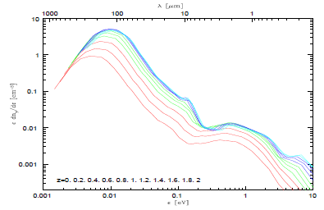
Evolution of cosmic star formation rate
Franceschini
et al. 2008

Slide 25
Galaxy Clusters

Slide 27
Dark matter
Bottom-up cosmology: small galaxies formed first, hence their density retains the cosmological density at the epoch of their turnaround (δρ/ρ ∼ 1.8).
Smaller, denser gals. have little/no SF – bigger, less dense gals. do have strong SF.
dSph MW satellite
best candidates
UFOs exciting candidates
Baryon infall: SF → SN expl. → winds → most of infalling baryons lost in small gals., but retained in bigger ones.

Slide 28
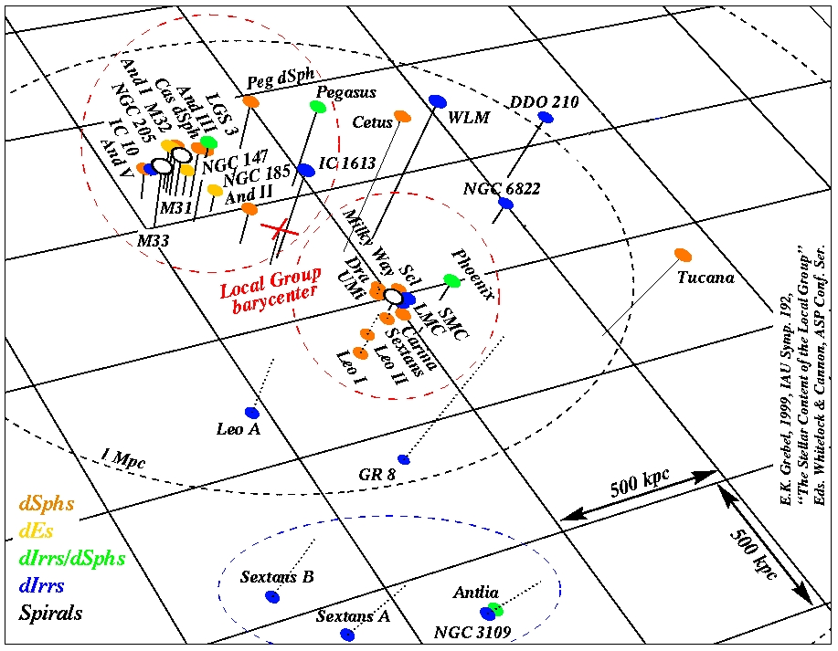

Slide 29
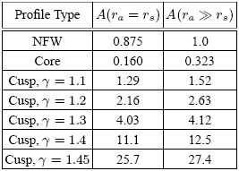
Draco dSph: modeling
d~80 kpc
Bergström &
Hooper 2006
total DM
annihil. rate
<σ_{A}v>, m_{χ}: WIMP annihil. cross section, mass
γ-ray flux
N_{γ}: γ-rays / annihil.
cusped
profile
maximizes
signal
cored
profile
γ-ray flux
r_{s} = 7 – 0.2 kpc
ρ₀ = 10⁷ – 10⁹ M_{ž} kpc⁻³
ρ₀² r_{s}³ = 0.03 – 6 M_{ž}² kpc⁻³

Slide 30
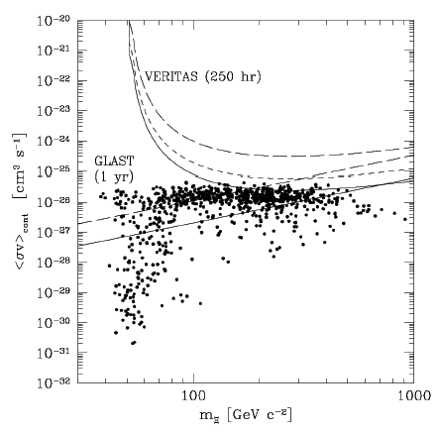
bb
t t
_
τ⁺τ⁻
_
min. cored
W⁺W⁻
max. cusped
MAGIC
40-h exp.
GLAST
1-yr exp.
ZZ
Bergström & Hooper 2006
IACT neutralino detection:
<σ_{A}v> ≥ 10⁻²⁵ cm³s⁻¹
Stoehr + 2003

Slide 31
CTA tech wish list
Higher Sensitivity at TeV energies (x10)
Deeper observations → More sources & more extended spectra
Higher Detection Area
Higher detection rates → Transient phenomena
Better Angular Resolution
Improved morphology studies → Structure of extended sources
Lower Threshold (some 10 GeV)
Pulsars, distant AGN, source mechanisms
Higher Energy Reach (PeV and beyond)
Cutoff region of galactic accelerators
Wide Field of View
Extended Sources, Surveys

Slide 32
CTA sensitivity
tyuujunas
hjv

Slide 33
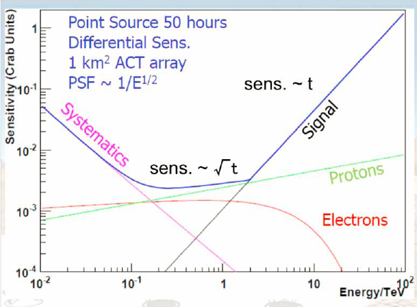
… limitations…

Slide 35
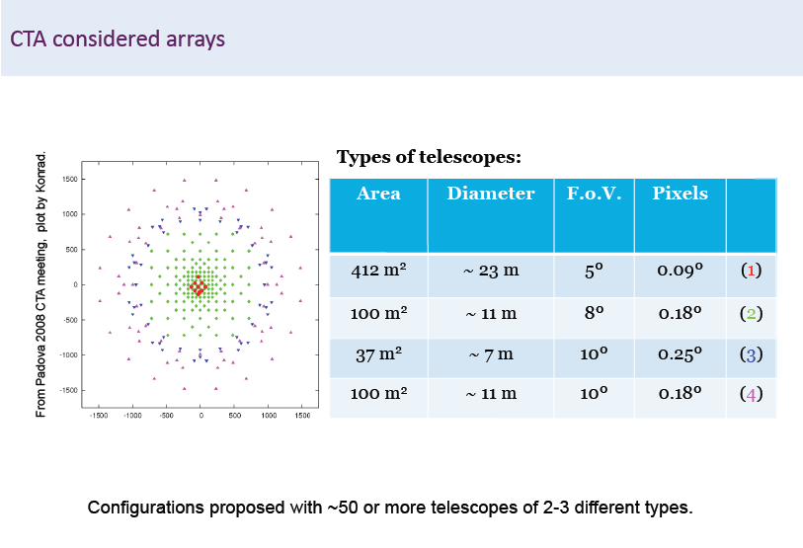
angular
resolution
field
of
view

Slide 36
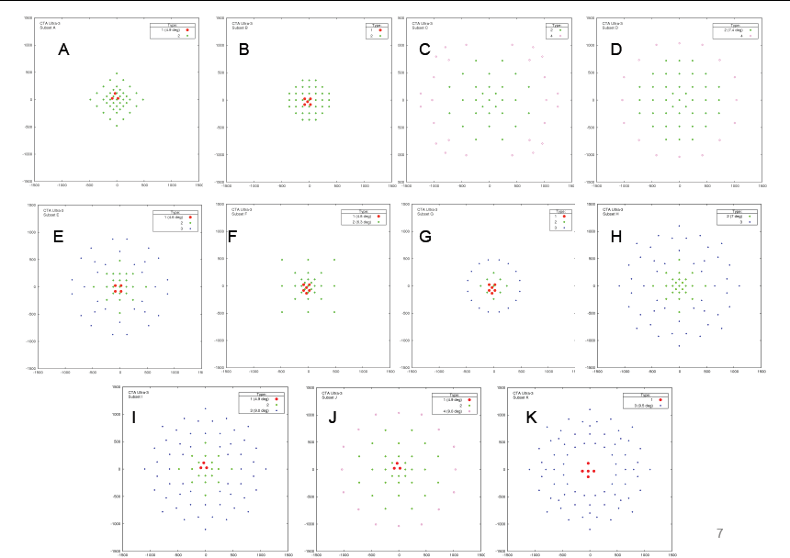

Slide 38
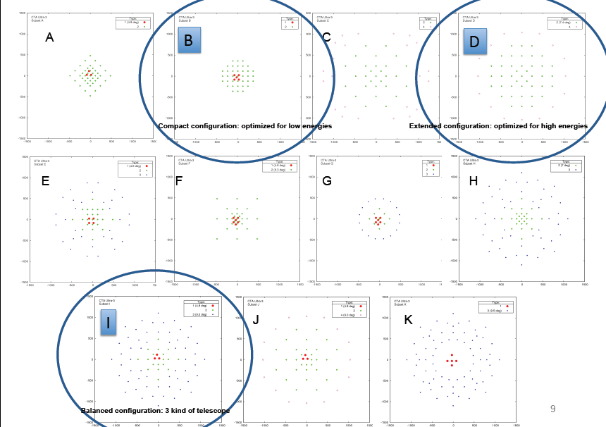

Slide 40
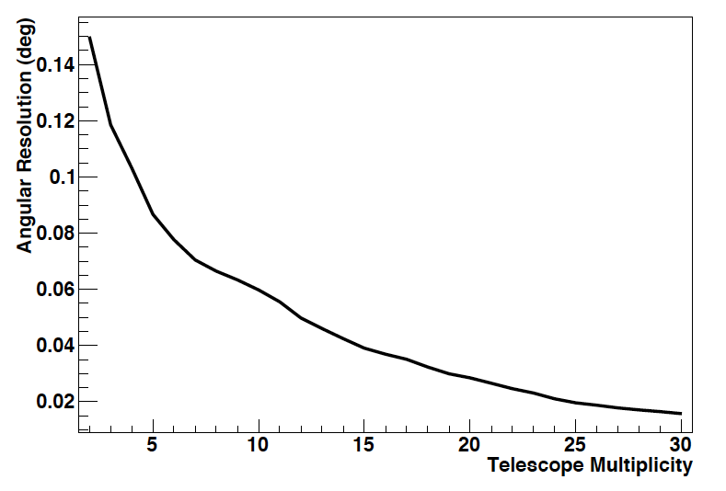
Basic message: CTA works!
Angular resolution

Slide 41
CTA: In Context
Space-based instruments only
optical
UV | X-ray | γ-ray | VHE γ-ray
Integral
10⁻¹¹
10⁻¹²
10⁻¹³
10⁻¹⁴
10⁻¹⁵
10⁻¹⁶
Fermi GST
νF_{ν} (erg cm⁻² s⁻¹)
Current
Instruments
More sensitive
XMM
HST
1 eV
1 keV
1 MeV
1 GeV
1 TeV
1 PeV
Energy

Slide 42
CTA: In Context
Space-based instruments only
optical
UV | X-ray | γ-ray | VHE γ-ray
Integral
10⁻¹¹
10⁻¹²
10⁻¹³
10⁻¹⁴
10⁻¹⁵
10⁻¹⁶
Fermi GST
νF_{ν} (erg cm⁻² s⁻¹)
Current
IACTs
More sensitive
CTA
XMM
HST
1 eV
1 keV
1 MeV
1 GeV
1 TeV
1 PeV
Energy

Slide 43
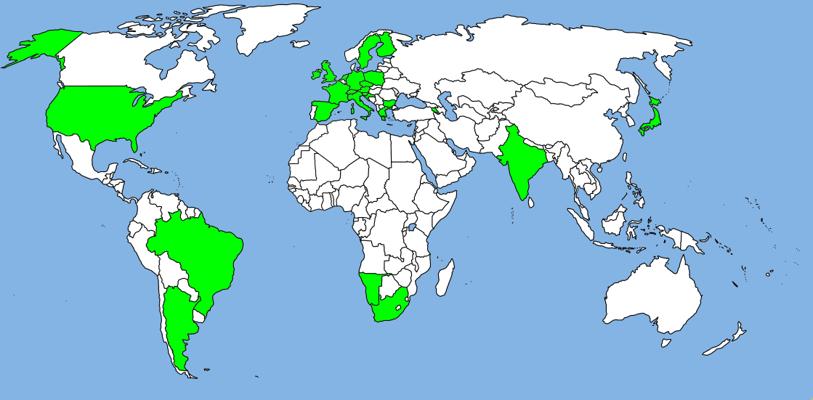
25 countries
132 institutes
734 people (+27% compared to last meeting)
220 FTEs
… by end of 2010

Slide 44
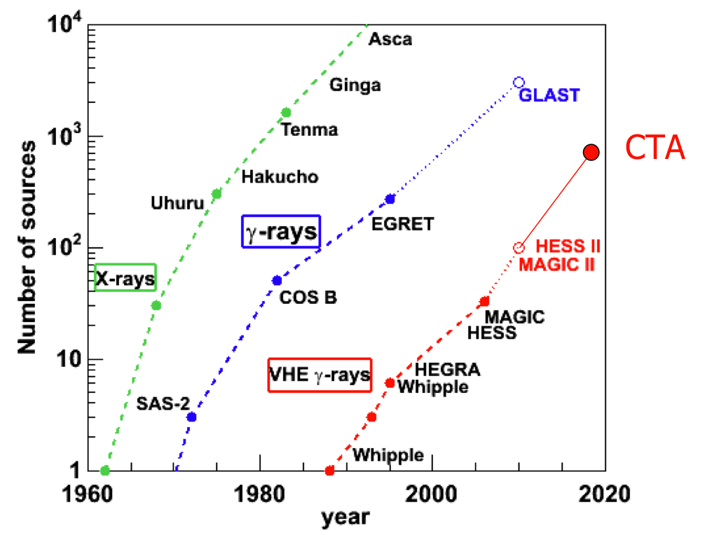
The Future

Slide 45
That’s all folks!

