Slide 1
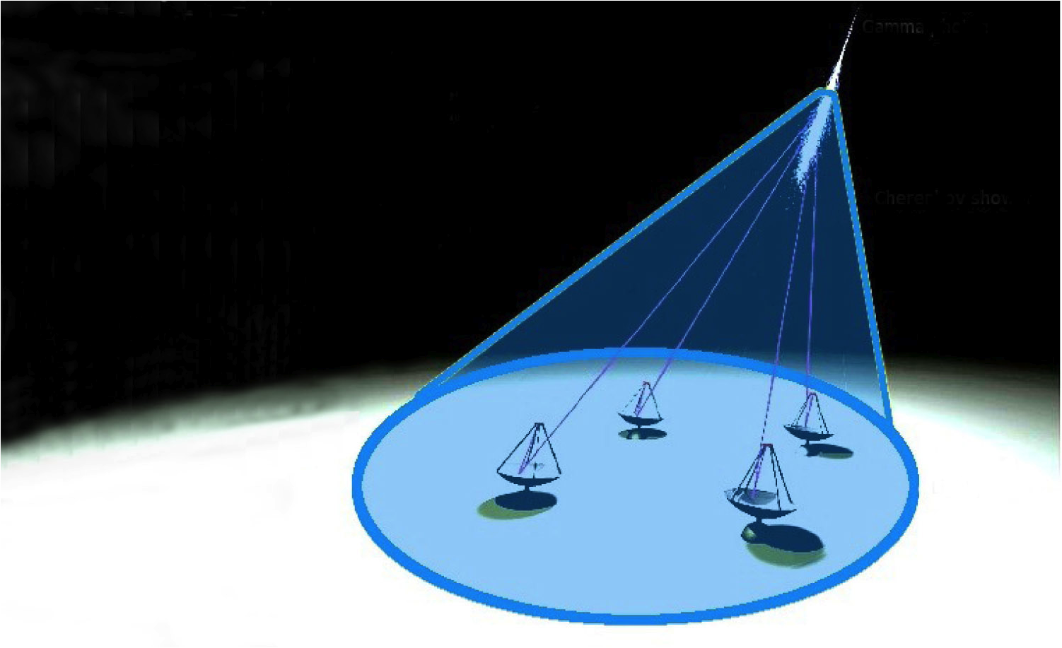
Technology overview for the IACT telescopes
FRANCESCO DAZZI
University of Udine & INFN Padova
(Mera-TeV meeting)
Merate, 5 October 2011

Slide 2
Summary
Radiation observed
Primary gamma ray
Extended air shower
Cherenkov light & NSB
Detector features
IACT telescopes
Reflective surface
Light sensors
Electronic chain
Amplification
Trigger
Readout & DAQ
Calibration system
Conclusions

Slide 3
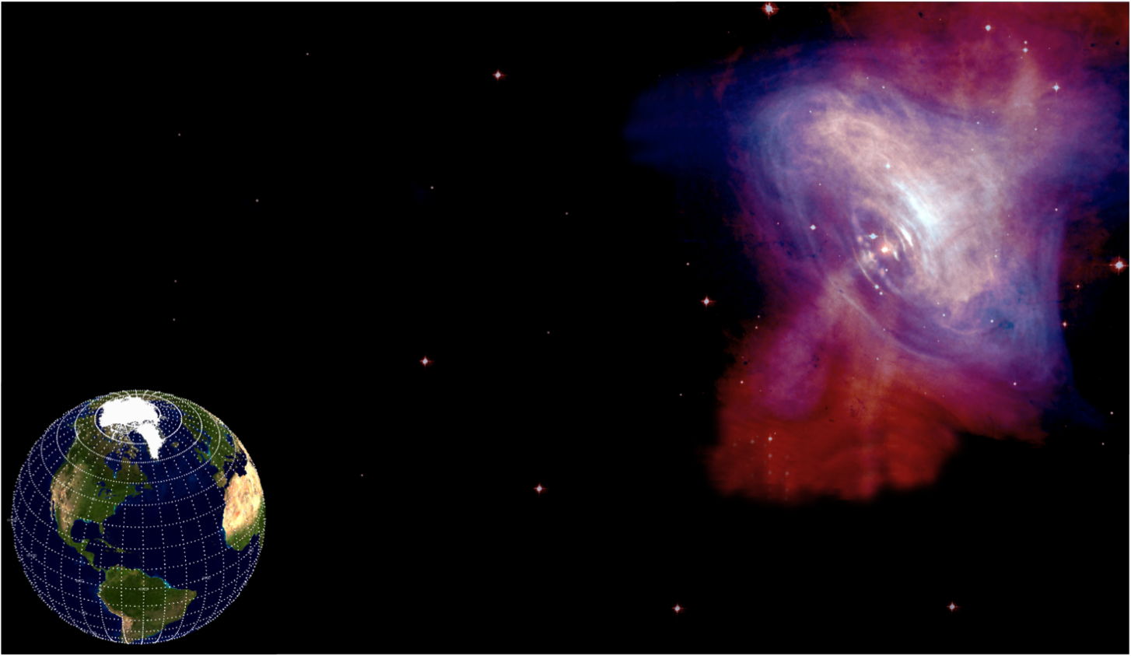
Radiation observed: primary γ-ray
γ-ray
Earth
Crab
Image combines optical data from Hubble (in red) and X-ray images from Chandra (in blue).
Charged particle

Slide 4
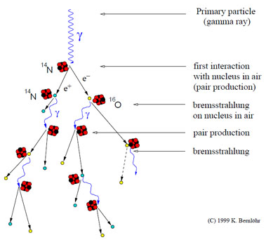
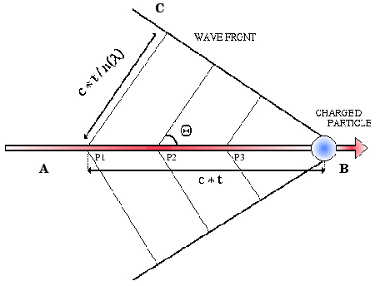
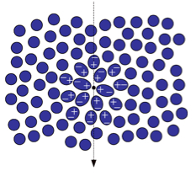
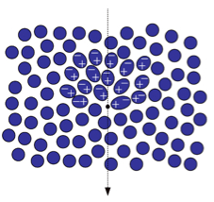
Radiation observed: EAS

Slide 5
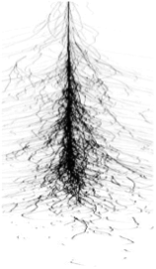
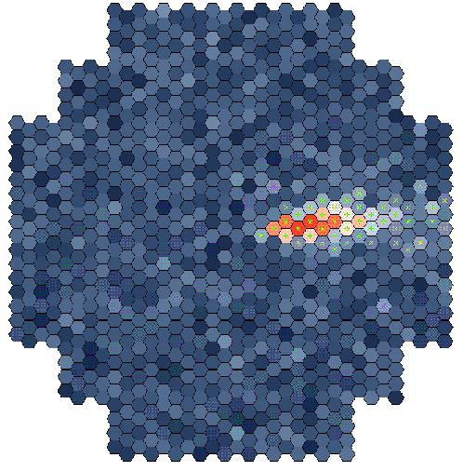
Radiation observed: EAS
Gamma-ray
Max shower
development
~ 10 km
Particle shower
~ 1º
Cherenkov light
Detection of TeV gamma rays using Cherenkov Telescopes
~ 120 m

Slide 6
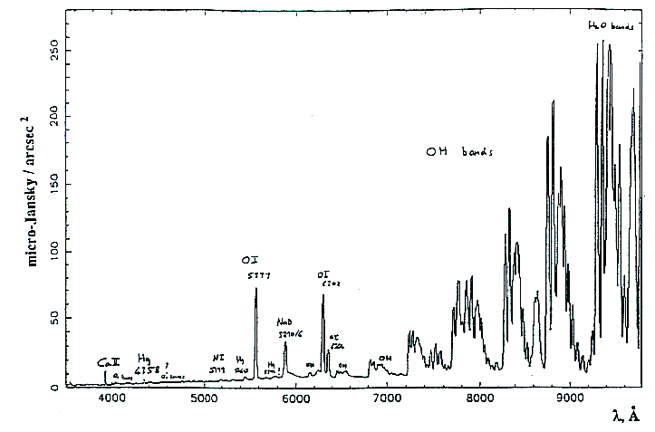
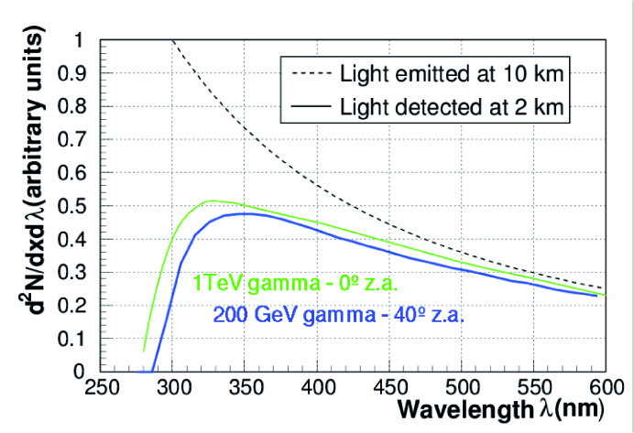
Radiation observed: Cherenkov light & NSB
Cherenkov light + NSB:
Cherenkov light from air showers: spectral range from 300 nm to 700 nm.
Below 300 nm absorbed by ozone
Above 600÷700 nm dominated by LONS
NSB is the Night Sky light Background composed by 2 groups:
LONS: diffuse light due to integrated starlight, air-glow & diffuse galactic light
NSB due to bright stars
EMISSION SPECTRUM OF LONS @ LA PALMA
EMISSION WATER
IN THE CHERENKOV RANGE: 300-600nm
Bialkali PMT
HYDROXIDE ION EMISSION
Φ(LONS) = (1.75 ± 0.4)•10¹² ph/m²•sr•s
R. Mirzoyan & E. Lorenz - MPI-PhE94-35
REGION OF INTEREST
CHERENKOV + NSB LIGHT @ 300 – 450 nm
SIGNAL
NOISE

Slide 7
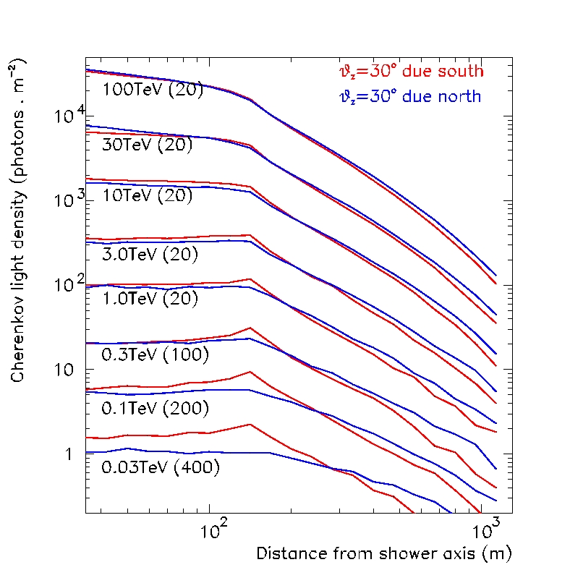
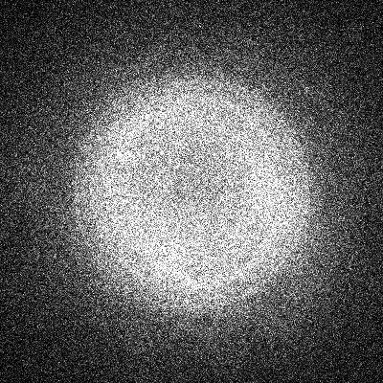
Radiation observed: Cherenkov light
Signal to noise ratio:
It is mainly a function of the trigger threshold & the sky region pointed (events @ trigger input).
Trigger hardware input ~ 1 MHz
Trigger hardware output ~ 200 Hz (only accidental events and muons rejected)
γ rate after software analysis ~ 3 γ/min => 0,05 Hz (hadrons rejection)
S/N ~ 5•10⁻⁸ (1 good event every 20 millions)
GROUND LIGHT DENSITY
CHERENKOV DENSITY
300 GeV γ-ray
400 m
Density < 10 photon/m² at 100 GeV

Slide 8
Radiation observed: detector features
Very low photons flux (e.g. Φ(E_{CRAB} > 1TeV) = ~ 2•10⁻¹¹ cm⁻²s⁻¹) =>
Large effective collection area (> 3•10⁴ m², dependency with altitude)
Small wavelength range detectable for Cherenkov light (300 ÷ 400 nm) =>
Optimization of the reflective surface and light sensors efficiency in that range
Very brief Cherenkov flash (few ns) =>
Fast electronics (GHz domain)
Very high background =>
Implementation of nice algorithms in the trigger and in the software cleaning to guarantee high rejection rate of noise and bad events
Reduce the energy threshold as much as possible
Try to get some overlap region with space observations

Slide 9
Radiation observed: detector features
Mathematical formula of the energy threshold:
The E_{th} of an IACT is inversely proportional to the number of collected photoelectrons
Large telescope dish
High reflectivity of mirrors and light collectors
High light sensors quantum efficiency
Mathematical formula of the significance of a detection:
The SNR of an IACT is inversely proportional to the energy threshold, the trigger gate and the collected NSB photons.
The trigger gate (G_{trigger}) should be similar to the spread time of Cherenkov photons (τ_{gamma}) => isochronous mirrors and electronics and fast trigger.
Solid angle on which photons fall in a single pixel (ΔΩ_{NSB}) should not be much greater than the angular size of the shower (Ω_{shower}) => small pixels.

Slide 10
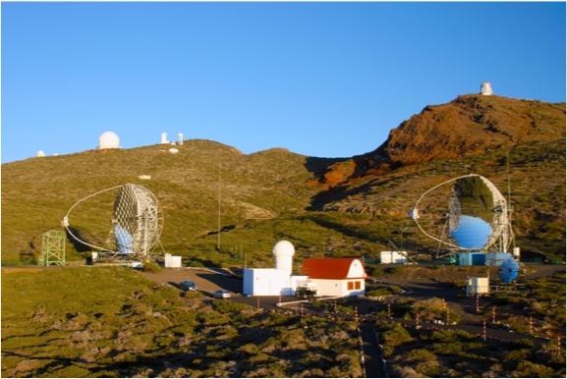
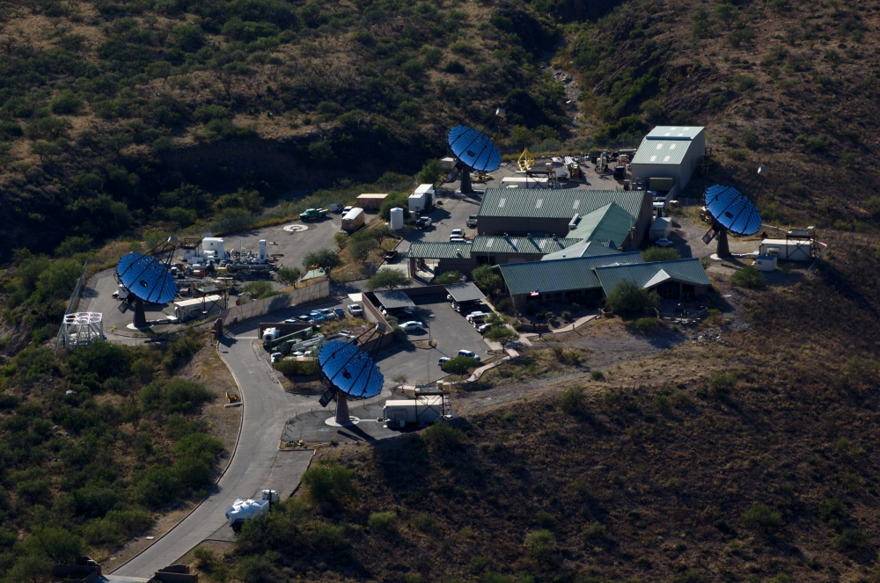
IACT telescopes
There are three important IACT telescope:
H.E.S.S. (Namibia)
MAGIC (Canary island of La Palma)
VERITAS (Southern Arizona)
MAGIC
VERITAS
HESS

Slide 11
IACT telescopes
Technical features | H.E.S.S. | MAGIC | VERITAS
Altitude | 1800 m | 2225 m | 1275 m
Telescope number | 4 | 2 | 2
Reflector diameter | 12 m | 17 m | 10 m
Reflector genre | Davies-Cotton | Parabolic | Davies-Cotton
Focal distance | 15 m | 17 m | 12 m
Reflective area | 107 m² | 236 m² | 106 m²
Mirrors technology | Glass | Al & glass | Glass
Number pixels | 960 | 576 - 1039 | 499
Camera FoV | 5° | 3.5° | 3.5°
Light sensors kind | PMT | PMT | PMT
Light sensors QE | 15% | 20-30% | 15-20%
Complete rotation | 3 min | 40 s | 3-4 min
Readout | 1 GS/s | 2 GS/s | 0.5 GS/s
20m
0.10°
Low energy threshold & calibration with satellites
Low energy threshold and high angular resolution
10m
0.15°
DISH DIAMETER
PIXEL SIZE
Cost limitation & potential upgrade with high QE sensors
Cost limitation & reduction of the channels number
5m
0.25°
5.0°
f/1.5
Reduction images truncation and nice observation of extended sources
Reduction aberrations
f/1.2
Performances | H.E.S.S. | MAGIC | VERITAS
Sensitivity | 0.7% 50h | 0.9% 50h | 0.7% 50h
Trigger threshold | 100 GeV | 25 GeV | 75 GeV
Energy resolution | 15% | 15% | 10-15%
Angular resolution | 0.06° | 0.09° | 0.03°
FoV
OPTICAL SYSTEM
3.5°
Cost limitation & potential use of heavy camera
Cost limitation & potential use of smaller pixels
2.5°
f/0.7

Slide 12
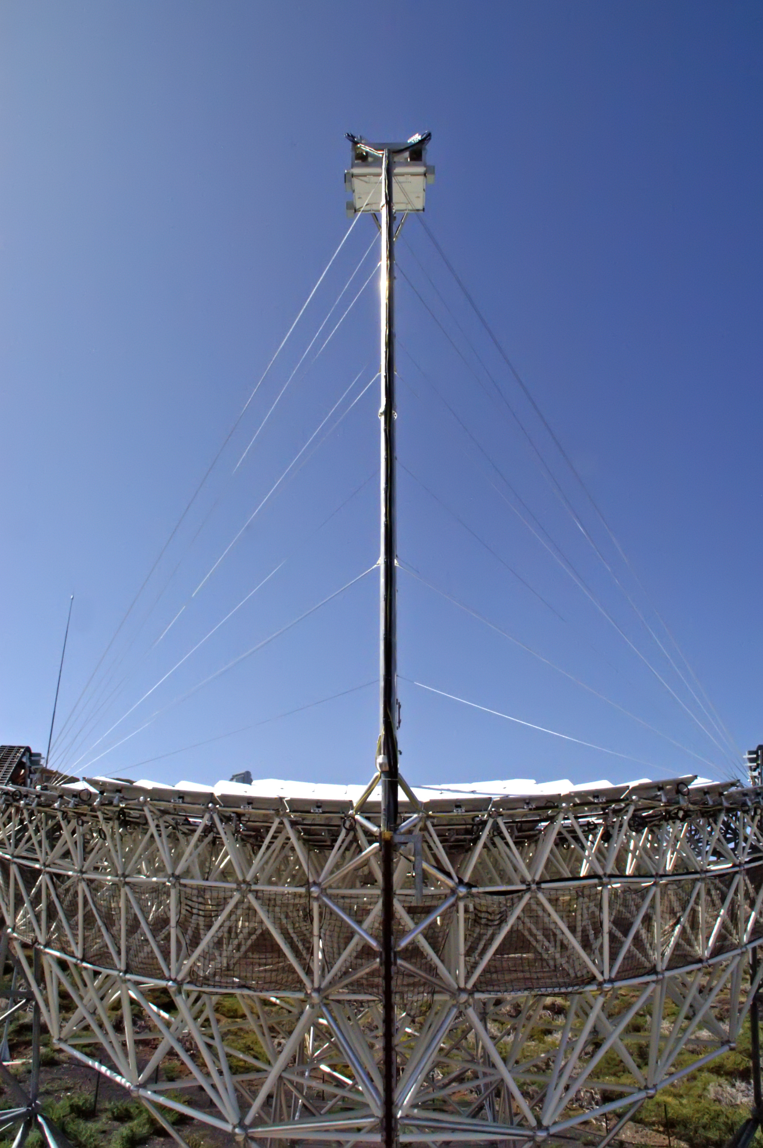
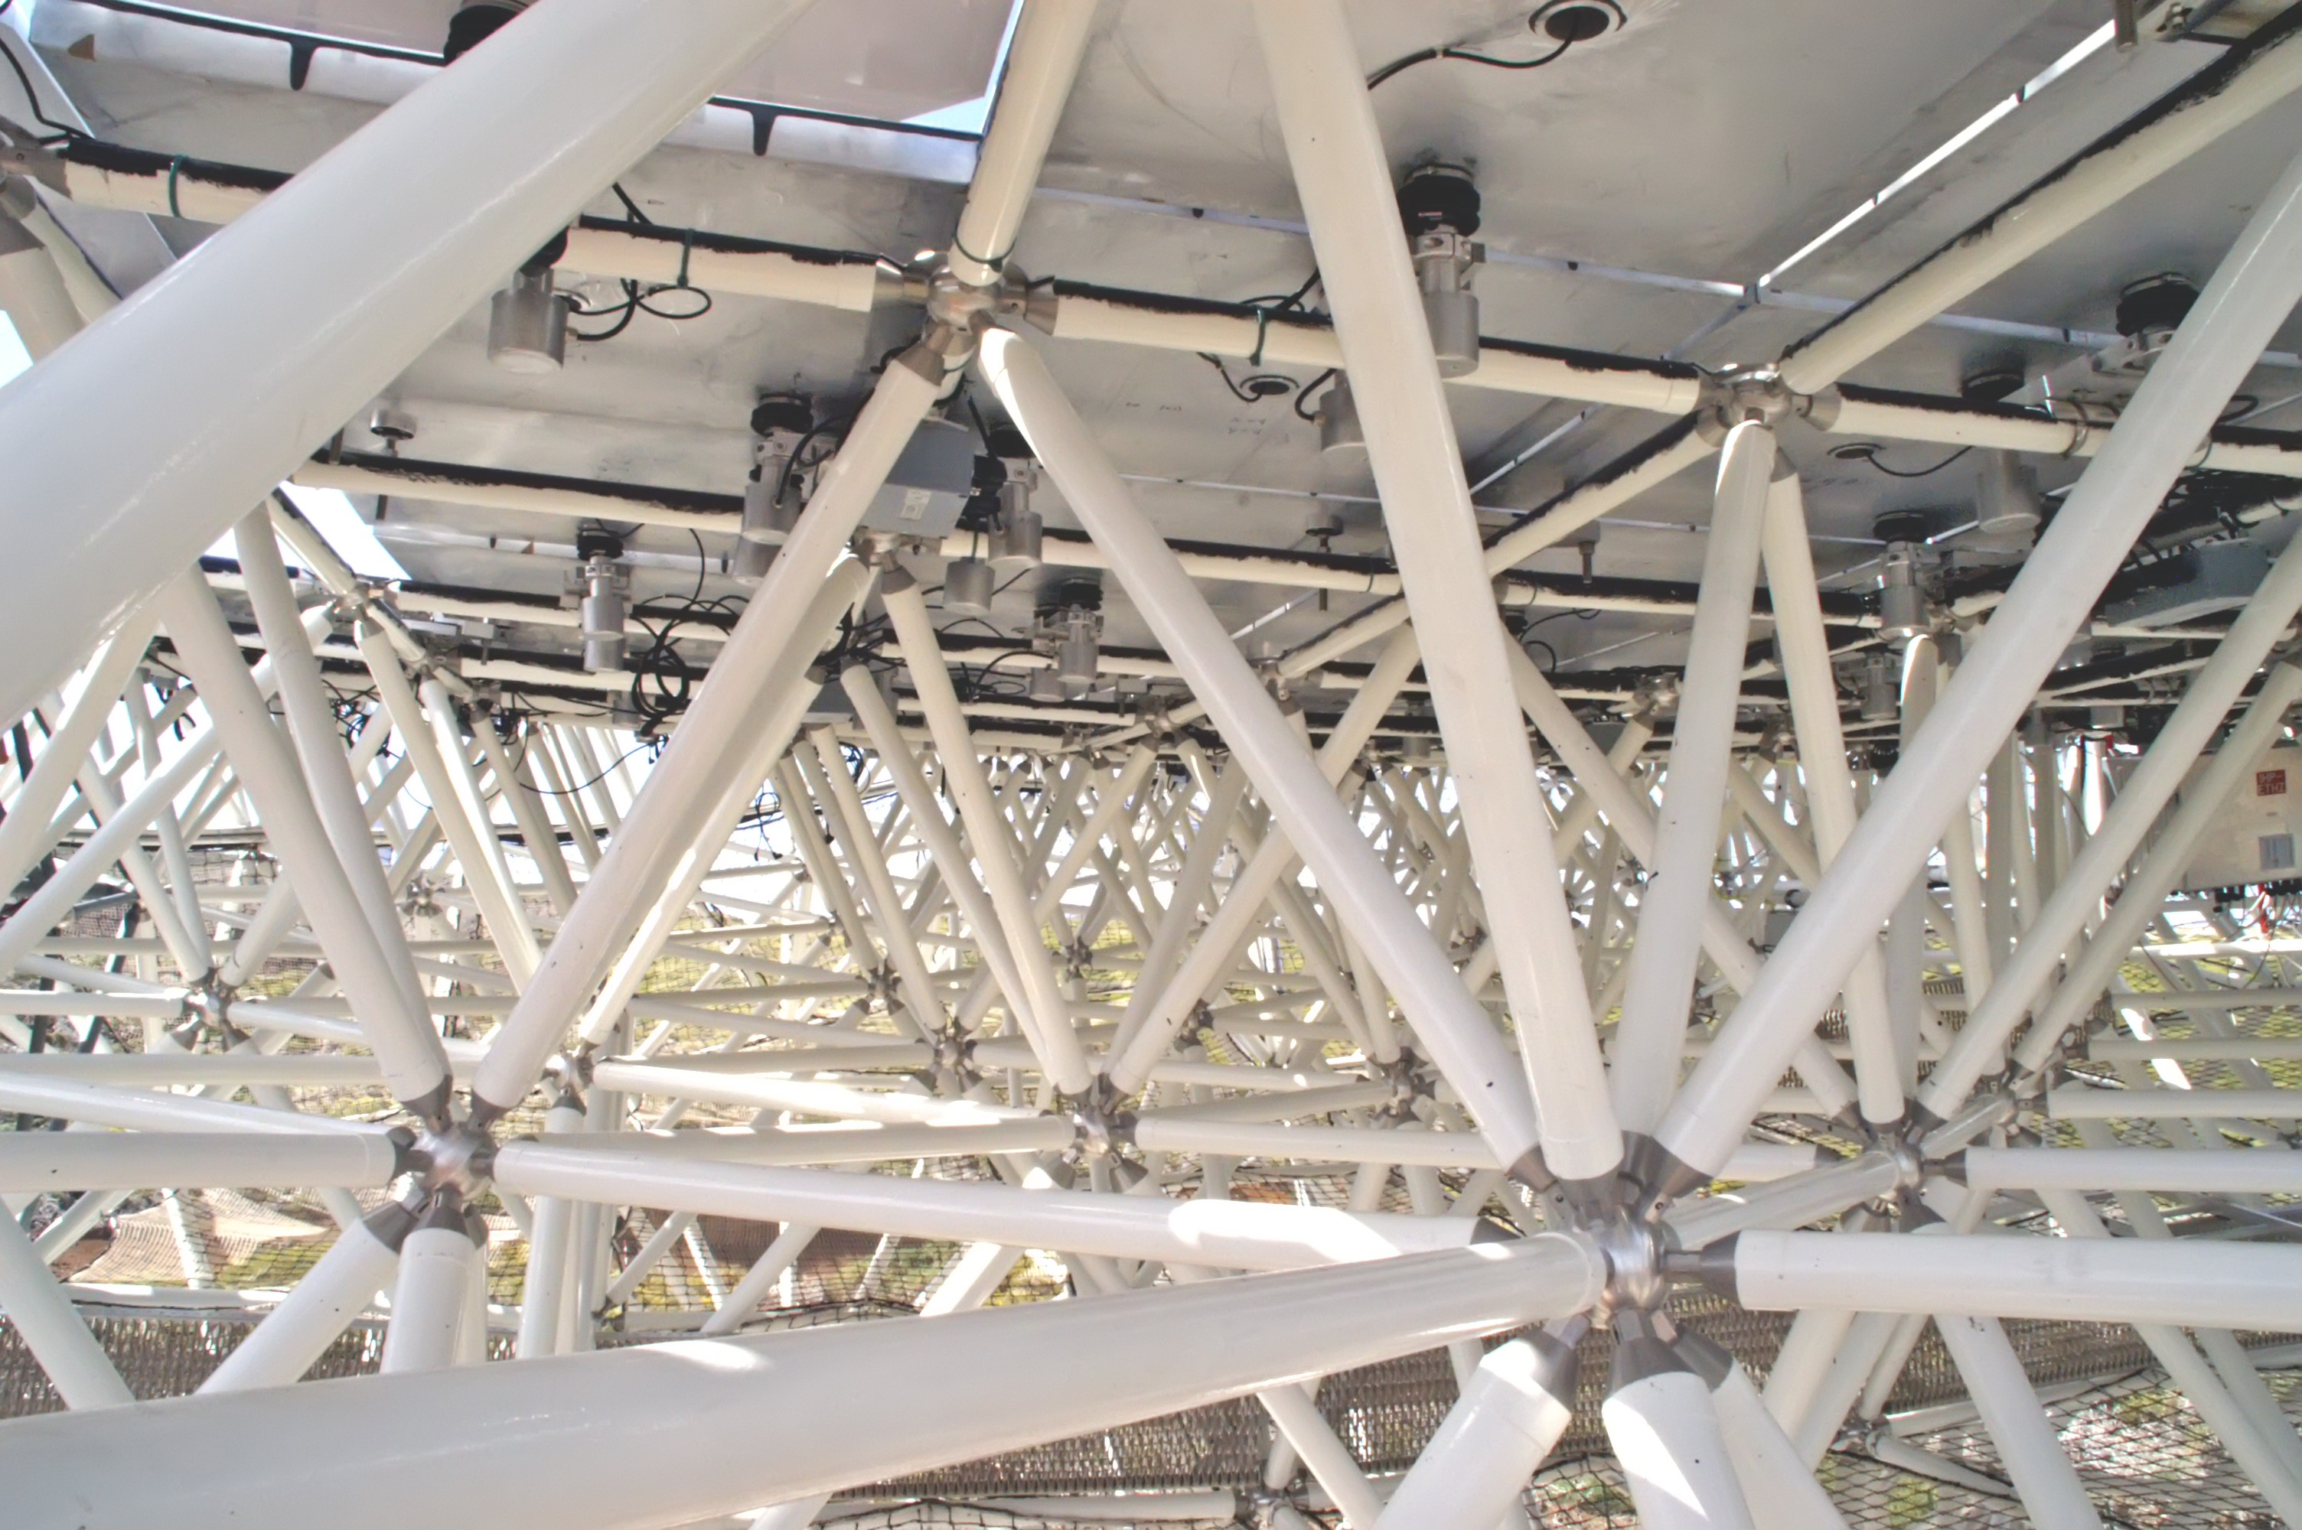
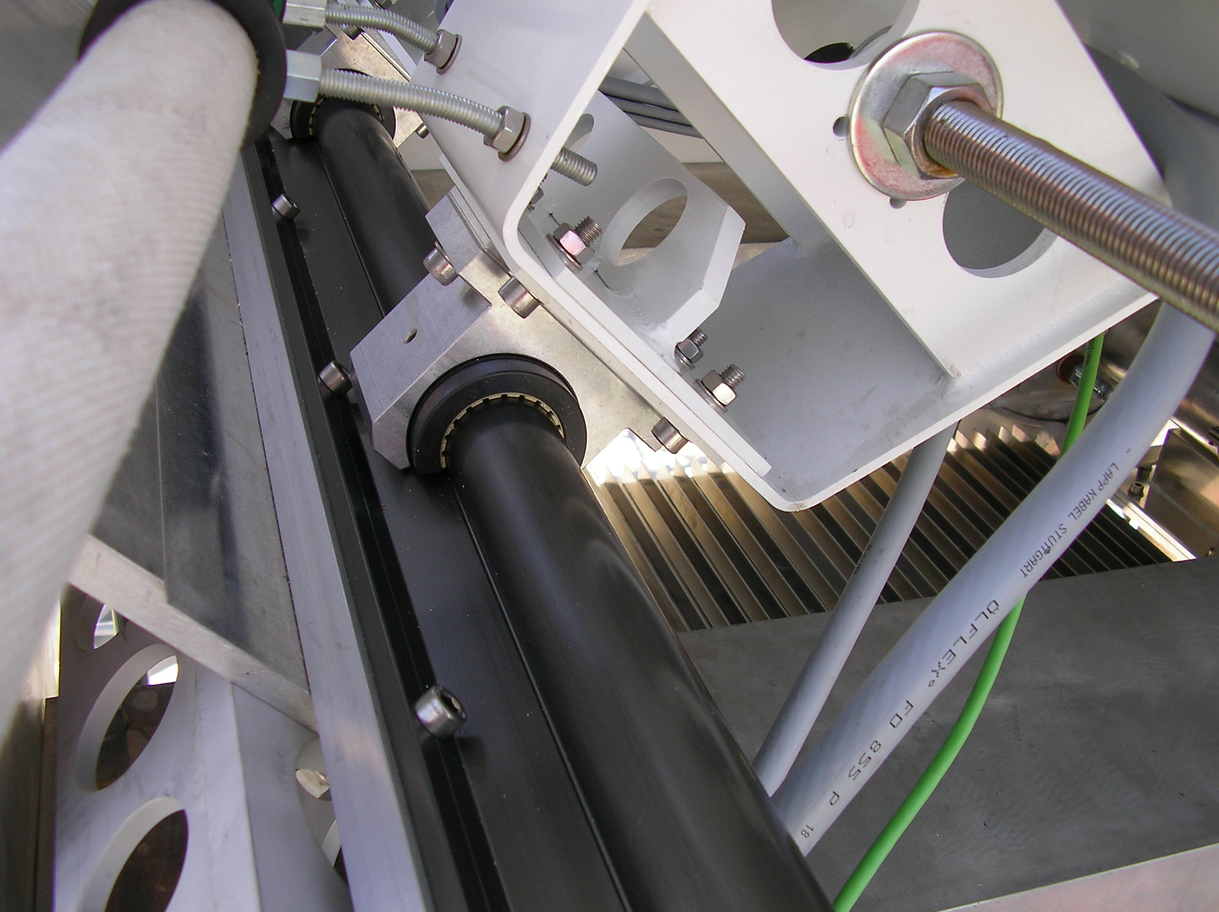
Reflective surface
Mirrors focusing:
FOCAL LENGTH
Reflectivity
Mirror’s orientation
~ 22 cm => 750 ps
Parabolic structure is isochronous, while Davies-Cotton not (spread of few ns, but better off-axis image).
PARABOLIC OR DAVIES-COTTON
STRUCTURE
MIRROR SUPPORT
CAMERA POSITION

Slide 13
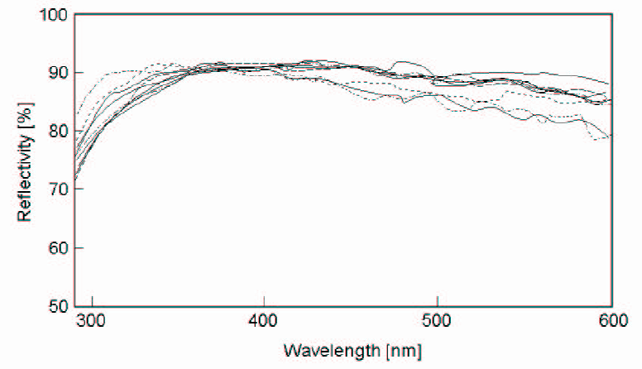
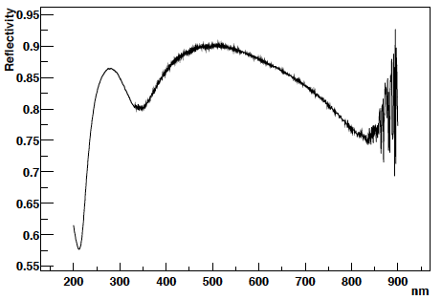
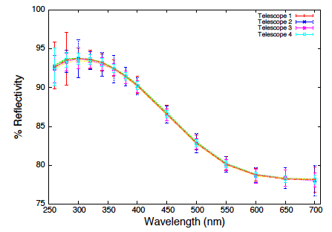
Reflective surface
Mirrors focusing:
Focal length
REFLECTIVITY
Mirror’s orientation
HESS
VERITAS
MAGIC

Slide 14
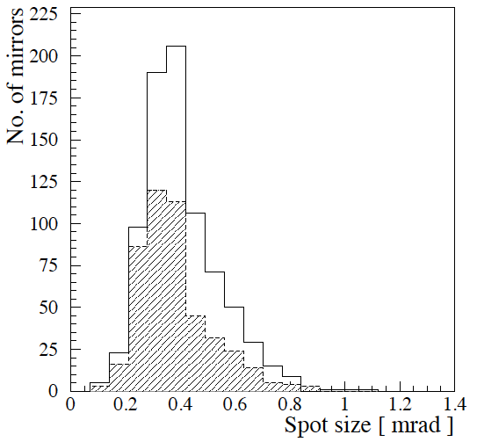
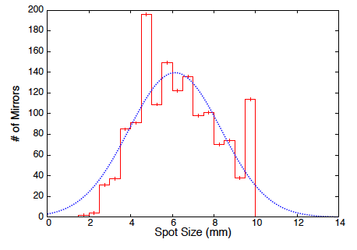
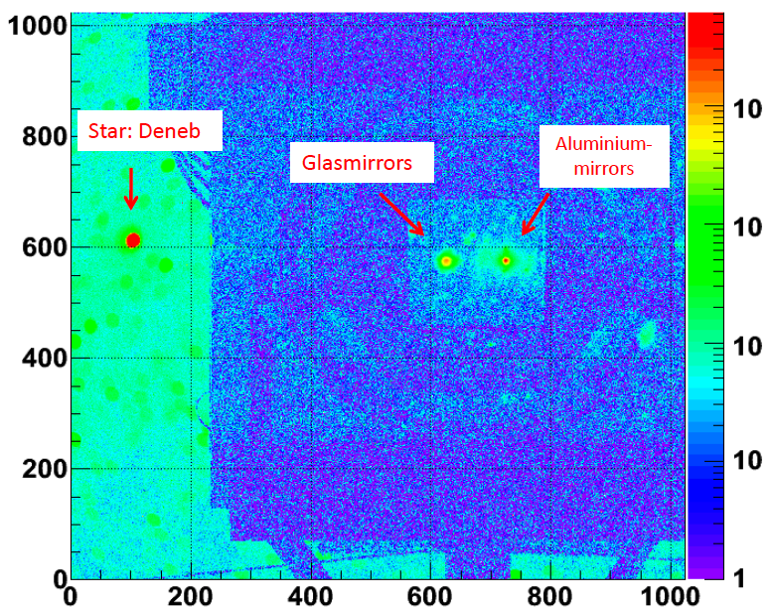
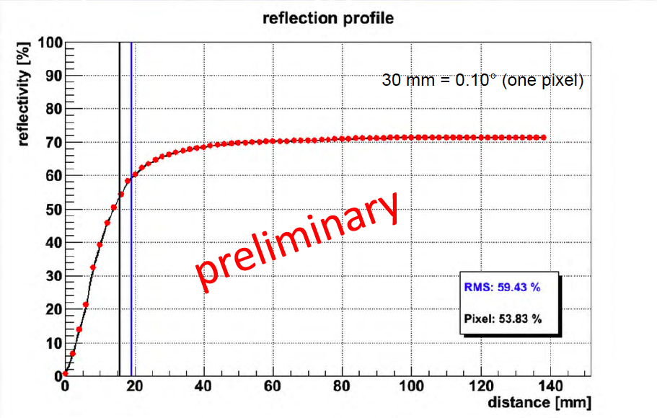
Reflective surface
Mirrors focusing:
Focal length
REFLECTIVITY
MIRROR’S ORIENTATION
HESS
VERITAS
~ -20%
MAGIC CASE

Slide 15
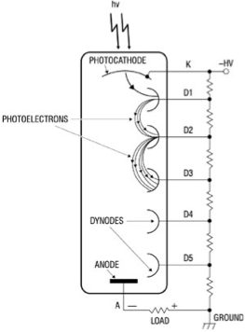
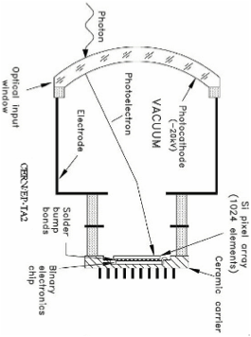
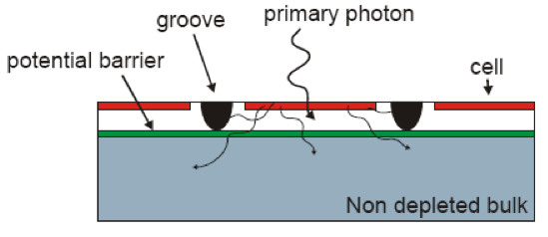
Light sensors
Light sensors type:
Traditional PMTs selected by the three main IACT collaborations.
It’s a well-known technology at relative low cost.
Unfortunately it is mature and so only small improvements are possible.
Low PDE between 20÷30%.
New photo sensors are progressing: HPD
High PDE ~ 45% (QE: 50÷55%).
Better photon resolution than PMT.
Very expensive.
Low gain and high voltage.
And SiPM
Extremely high PDE between 60÷90%.
The best photon resolution.
Innovative and promising product.
Low voltage.
High dark current.
Not negligible crosstalk.
Small active area.
Low dynamic range

Slide 16
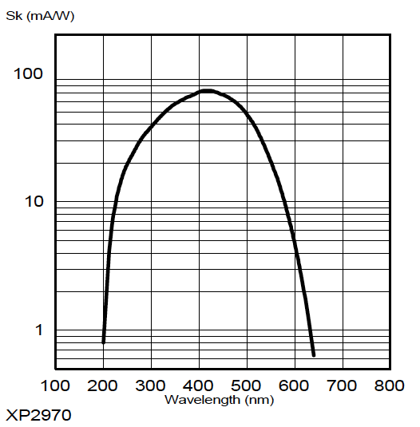
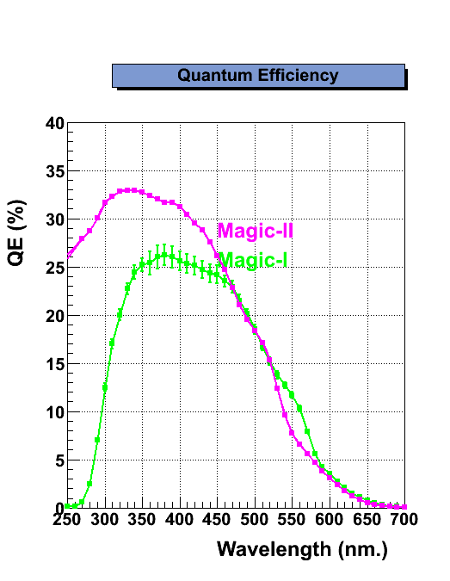
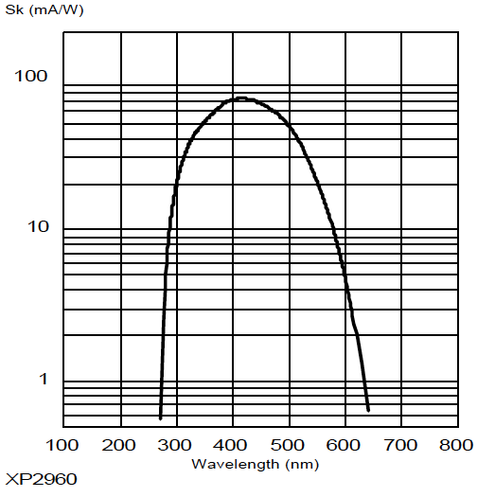
Light sensors
PMTs kind:
HESS: Photonis XP2960
MAGIC: Hamamatsu R10408
VERITAS: Photonis XP2970
VERITAS
23%
MAGIC
HESS
22%

Slide 17
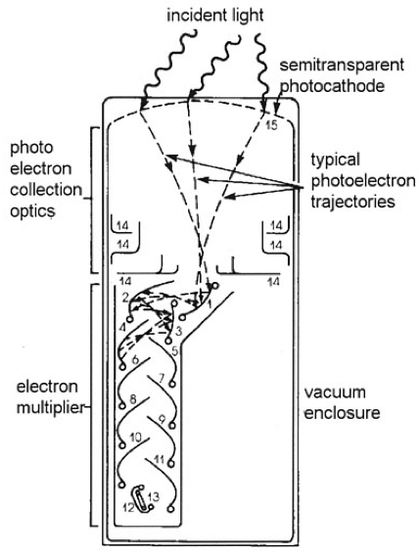
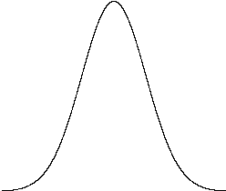
Light sensors
The main difficulty is to equalize the PMTs answer.
The variables that change PMTs electrical output are:
PDE (Photo Detection Efficiency).
Electric field between cathode & anode.
Dynodes gain.
Goal:
Equal electrical answer, when PMTs are hit by the same light.
PDE # photons => # phe
≠ SHAPE
≠ DELAY
ELECTRIC FIELD E ∝ electrons speed
(Fixed active load preferred)
Low E => wide signal
High E => tight signal
≠ CHARGE
Low Gain => small area
High Gain => great area
DYNODES GAIN Gain ∝ charge

Slide 18
Light sensors
It’s impossible to obtain a completely equal electrical response (same charge, shape, amplitude & width).
Typical approach:
Get the same charge.
Fix the threshold in terms of photoelectrons and not in volts.
Minimize the skew between channels.
DT_1
DT_2
≠ SHAPE BUT SAME Q
Amplitude_2
Amplitude_1
Width_1
Width_2
Delay_1
Delay_2
SAME NUMBER OF PHEs, BUT DIFFERENT ELECTRICAL SIGNAL:
EQUALIZATION MANDATORY!!!

Slide 19
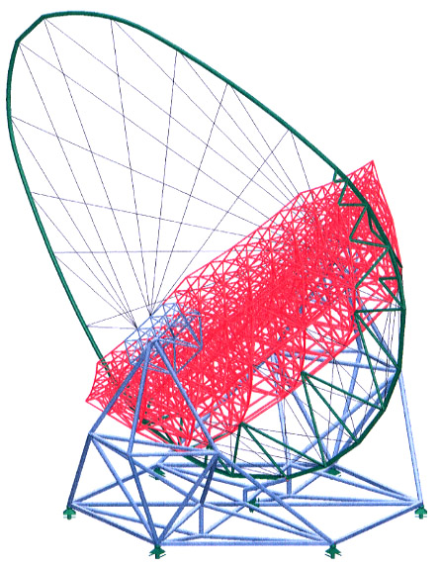
Electronic chain
FRONT END
electronics
Local Trigger
Local Trigger
FRONT END
electronics
Readout - DAQ
Readout - DAQ
STORAGE
Stereo Trigger
STORAGE
Readout - DAQ
Readout - DAQ
FRONT END
electronics
Local Trigger
Local Trigger
FRONT END
electronics

Slide 20
Electronic chain: amplification
Average gain calculation MAGIC-II:
PMTs gain => 3.2•10⁴ (when 1 phe is produced)
Preamplifier => x 19.5 (25.8 db) with bandwidth of 800 MHz
Optical transmission => x 0.1 (-20 db) with bandwidth modulation of 2.5 Gb/s
Optical fibers => x 0.95 (-0.4 db) [2.7db/Km]
Receiver boards => x 8.4 (18.5 db) with bandwidth of 530 MHz
VERITAS:
PMTs gain => 2•10⁵
Preamplifier => 2mV/phe with bandwidth 1GHz
Cable transmission => 50m with RG-59 cable to the CDF trigger
Analog amplification => 8÷16mV/phe with bandwidth of 500 MHz
HESS:
PMTs gain => 2•10⁵
Front-end high gain => x -54 (~97mV for 1phe)
Front-end high gain noise => ~20mV, namely 0.2phe
Front-end low gain => x -4
Front-end low gain noise => ~7mV, namely 1phe

Slide 21
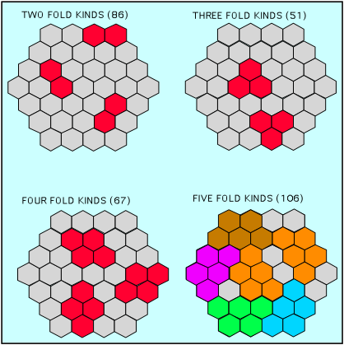
Electronic chain: Trigger
General trigger concept for IACT Telescopes:
Detect close compact images produced by few photons and reject noise (NSB & PMT afterpulses), preventing DAQ saturation.
Based on different levels. For instance MAGIC standard trigger:
L0: accept signals higher then an adjustable thresholds.
L1: fast coincidence (some nanoseconds) between neighbour PMTs (2-3-4-5 NN logic).
L2: enhanced topologic selection made with tree structured lookup table system and apply a prescaler factor.
L3: stereoscopic coincidence (100ns) between telescopes.
VERITAS trigger:
L1: CDF discriminator for each pixel at 4.2phe.
L2: 3 adjacent pixels exceed the threshold in 10ns.
L3: stereoscopic coincidence between telescopes.
HESS trigger:
L1: single pixel threshold at 4phe for 1.5ns.
L2: coincidence of 3 pixels in a sector of 64 pixels.
L3: stereoscopic coincidence (80ns) between at least 2 telescopes.
V
TH
OK
NO
t
An on fly hardware trigger is mandatory, because the maximum DAQ rate is ~ 1KHz!

Slide 22
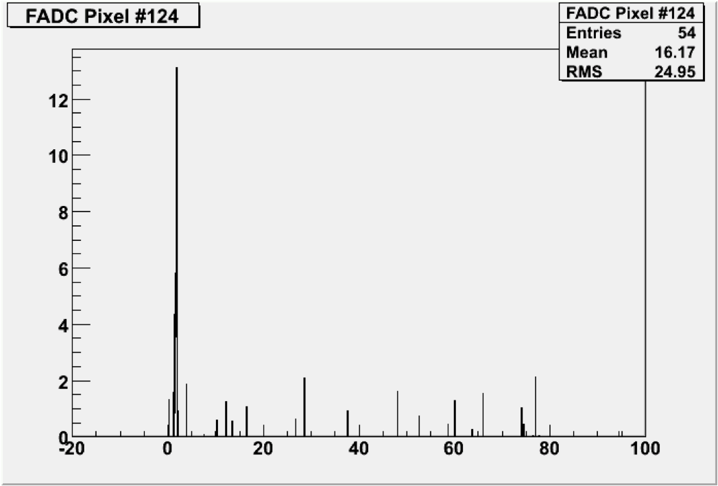
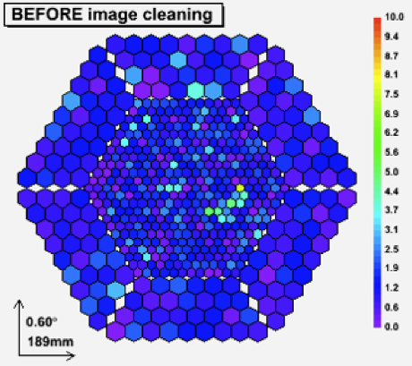
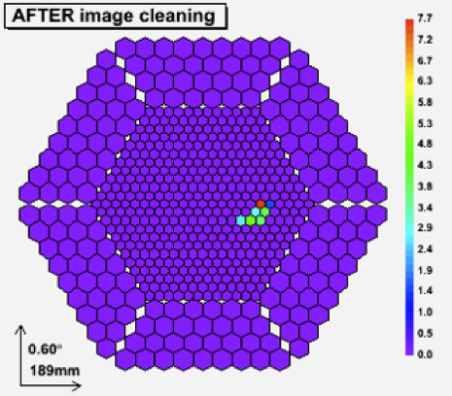
Electronic chain: Trigger
Basic idea (innovative):
Summing up all single photons increases signal to noise ratio.
Sum up a large region increases the signal to noise ratio than requiring individual pixels to trigger, because images of low energy showers extend over many pixels. 19 pixels versus 4 close compact.
V (a.u.)
signal
Threshold (digital)
Threshold (analog)
signal
NSB
t (a.u.)

Slide 23
Electronic chain: Trigger
Stars in the trigger FoV:
Stars light is very strong and can activate the trigger.
Stars move around the camera.
On-line solution:
Control the LT0 rate. In case there is a star, it explodes.
MIR increases the LT0 thresholds for the affected pixels.
When the star moves a little bit away, the old affected pixels are restored with the proper thresholds and new pixels are changed.
Normal thresholds
High thresholds

Slide 24
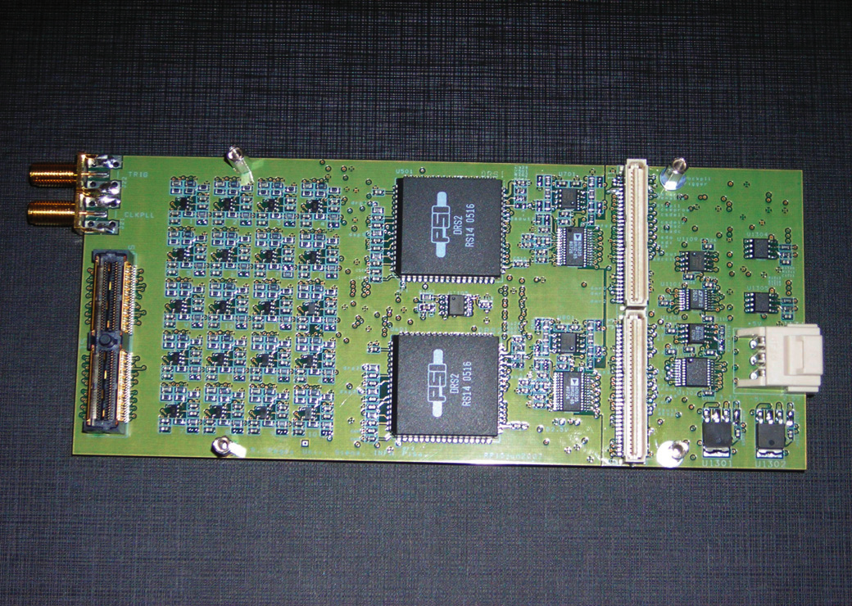
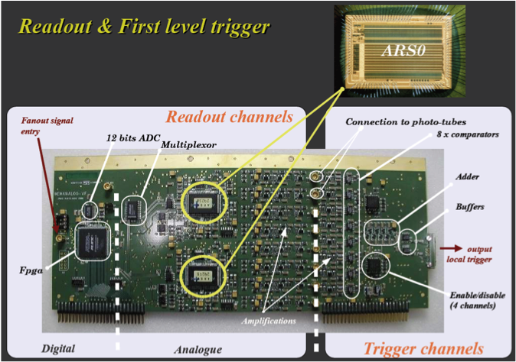
Electronic chain: Readout & DAQ
General DAQ features for IACT Telescopes:
Fast sampling to reconstruct the brief Cherenkov flash (> 0.5GS/s).
High bandwidth to conserve the analogue signal shape of few ns (> 300MHz).
High stability for a stable long data taking (many hours).
MAGIC DAQ
Based on the analogue ring DRS chip (2GS/s), with a memory depth of 512ns
VERITAS DAQ:
Commercial 8 bits FADC (0.5GS/s) with a memory depth of 64μs
HESS DAQ:
Based on analogue ring sampler ARS0 circuit (1GS/s).

Slide 25
Calibration system
Calibration concept:
It is the operation to settle a device under test (DUT), using standard and well known test instruments (TI), in order to improve its precision.
Calibration procedure for MAGIC:
Reflective surface:
Mirror’s focusing
Mirror’s reflectivity
Flat-fielding PMTs:
Dead pixels
Flat-fielding charge
Flat-fielding receiver boards (LT0):
Thresholds using IPRscan (Individual Pixel Rate scan) NSB (Night Sky Background)
Thresholds using IPRscan calibration laser
Flat-fielding trigger level one (LT1):
Delays synchronization
Effective gate equalization
DAQ linearity:
Domino calibration run
Data taking:
Calibration & pedestal run

Slide 26
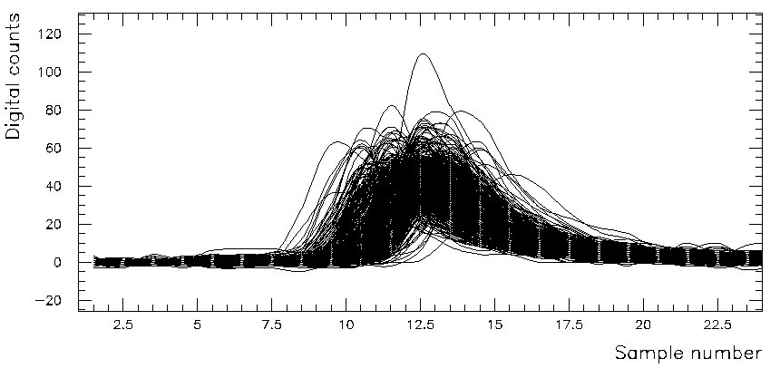
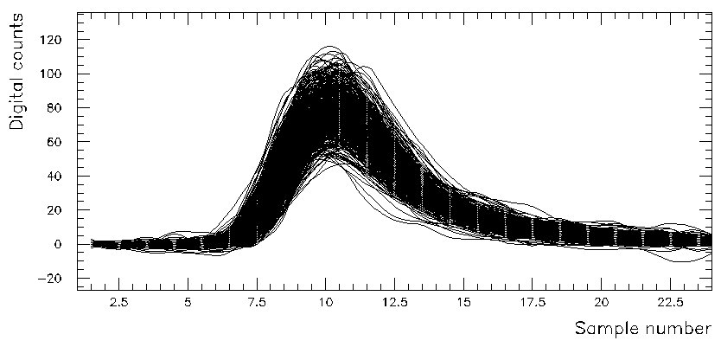
Calibration system
Trigger point of view (catch the event) [magenta line]:
Equalized gain means equalized amplitude => Flat-fielding thresholds
FADC point of view (reconstruction of the event) [brown line]:
Equalized gain means equalized charge => Calibration runs + software calibration
Receiver
Trigger
LT1
Trigger
LT2
PMT
Transmitter
Optical Fibre
FADC
Synchronization control
Raw data
Time and gain corrected data

Slide 27
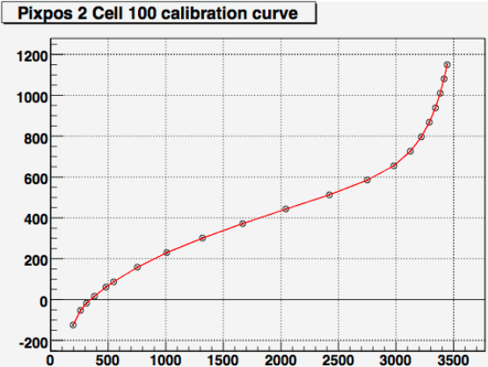
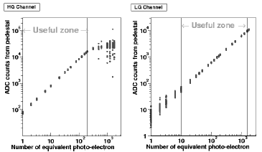
Calibration system
Very wide dynamic range:
HESS up to 1600 phe
MAGIC to 900 phe
VERITAS up to 1800 phe
DAQ linearity control:
Characterization of the FADC.
Dedicated linearity runs.
Saturation
DRS input (mV)
Small signals
DRS output (FADC counts)
HESS
MAGIC

Slide 28
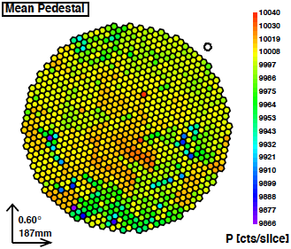
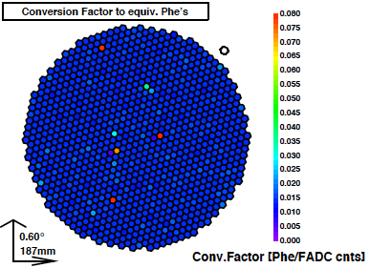
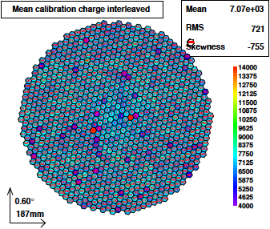
Calibration system
Online calibration:
There are many short terms variations:
Temperature
Stars in the FoV [ΔQ ~ √phe]
Moon
Atmospherical conditions: clouds, humidity, calima, etc…
Electronic noise
Electronic fluctuations: FADC baseline, VCSEL stability
Continuous monitoring:
Interleaved calibration runs => conversion factors
Interleaved pedestal runs (It is the FADC output when the input is zero)

Slide 29
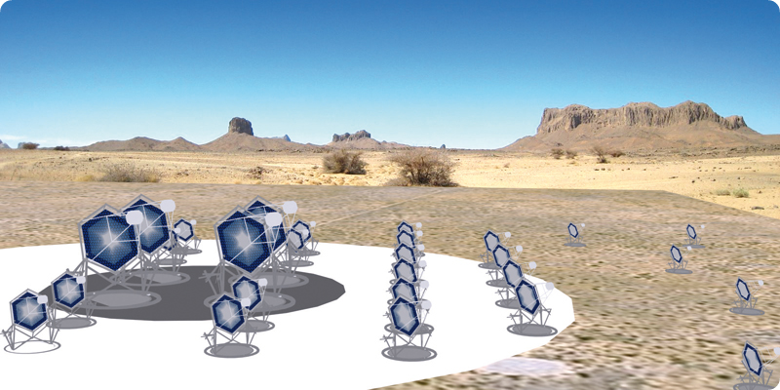
Conclusions
The main IACT telescopes are: HESS, MAGIC & VERITAS.
Successful experiments with many important publications.
The total cost compared to the accelerator factories is negligible.
The total cost of MAGIC telescopes is around 12 million euro.
The Italian annual contribution for LHC is around 80 million euro (total cost ~ 7.5 billion euro).
Less time for the construction.
The construction of HESS & MAGIC has been done in 3-4 years.
LHC was approved in away back in 1995.
Good physics, studying extreme astronomical environments, where the released energy is even higher then in the colliders.
The future is CTA, an array of 50-100 IACT telescopes.
29
Notes:
29

Slide 30
Backup slides
30
Notes:
30

Slide 31
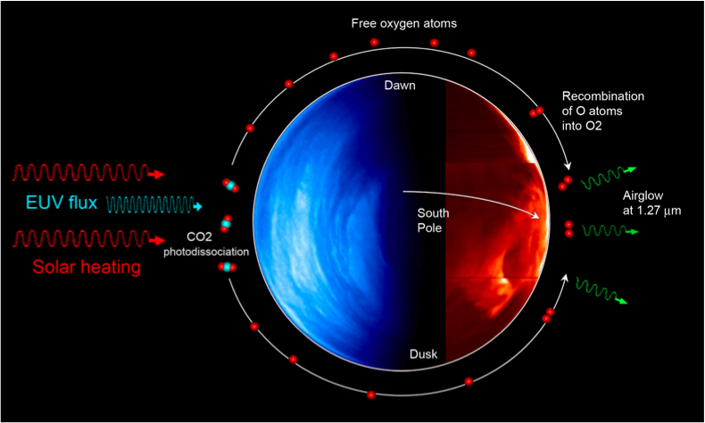
Background
LONS components:
Air-glow
Weak light emitted by atoms in the upper atmosphere, due to UV radiation excitation.
Zodiacal light
Very faint light caused by sunlight scattered by space dust in the zodiacal cloud.
Diffuse galactic light
Light due to starlight reflected and scattered by interstellar dust near the galactic plane.
Integrated starlight
Light due to starlight reflected and scattered by interstellar dust.

Slide 32
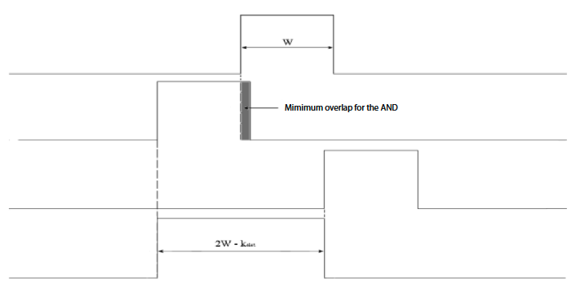
Trigger gate
Trigger gate concept:
Mathematics: the space where the intersection between signal sets is not void.
Electronics: the time where the AND between signals is at the logic state ‘1’.
Signal #1
(Reference)
Signal #2
(Minimum delay)
Signal #2
(Maximum delay)
GATE
(Overlap zone)

Slide 33
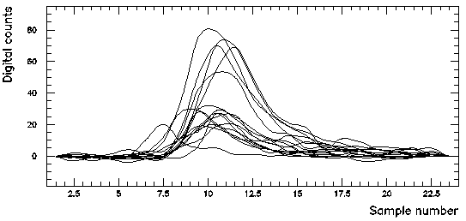
Calibration
Calibration ingredients:
Photo Detection Efficiency of each pixel
Gain of each pixel (relative and absolute)
Relative Time delay between pixel and telescope
Calibration method:
Uniform light flash injection (Flat fielding)
PMTs PDE (Single-photoelectron, F-factor)
Muons signal
Pedestal subtraction (Trigger without shower )
Raw data
10 ns
Time and gain corrected data
Signal

Slide 34
Electronic chain
HESS
VERITAS

