Slide 1
The telescopes from the technological point of view:
structures and mirrors for IACTs
Rodolfo Canestrari
INAF-Astronomical Observatory of Brera

Slide 2
Outline
Introduction
The structures
  Basics
  Stow position
  Nomenclature
Current experiments
The mirrors
  The cold glass slumping technology

Slide 3
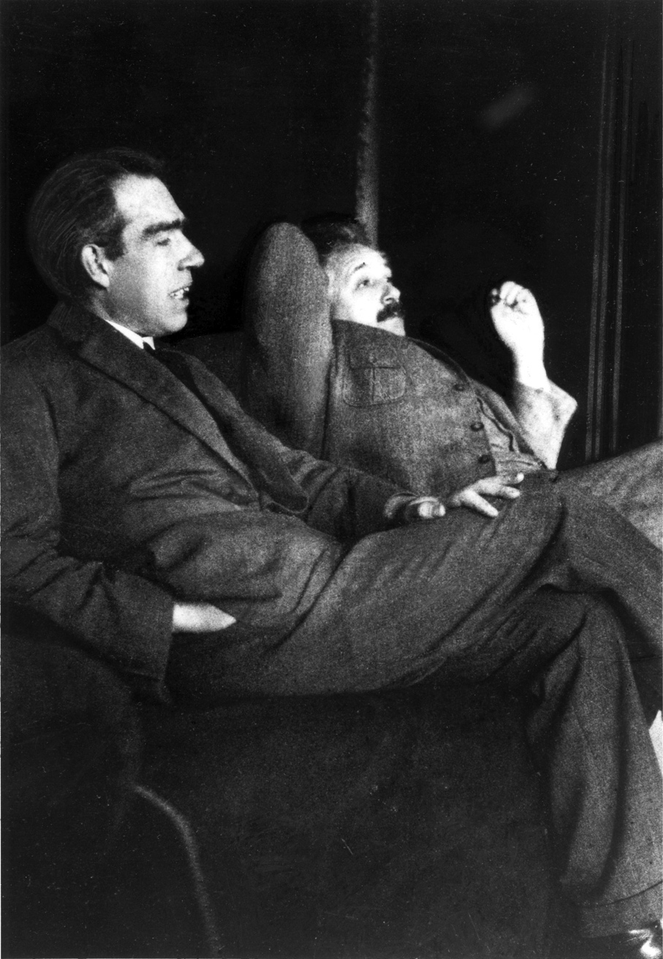
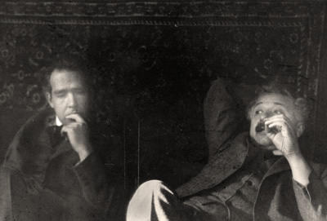
Introduction
Meanwhile two guys are wasting time talking about the Two Chief World Systems
Albert: “Dio non gioca a dadi con l'universo.”
Niels: “Non dire a Dio come deve giocare.”

Slide 4
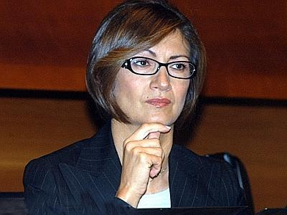
Introduction
Luckily, someone else does the dirty job!
Mariastella: […] “alla costruzione del tunnel tra il Cern e i laboratori del Gran Sasso” […]

Slide 5
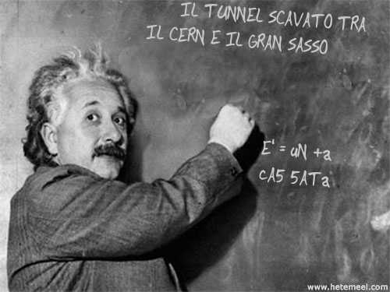
Introduction
Luckily, someone else does the dirty job!
Mariastella: […] “alla costruzione del tunnel tra il Cern e i laboratori del Gran Sasso” […]

Slide 6
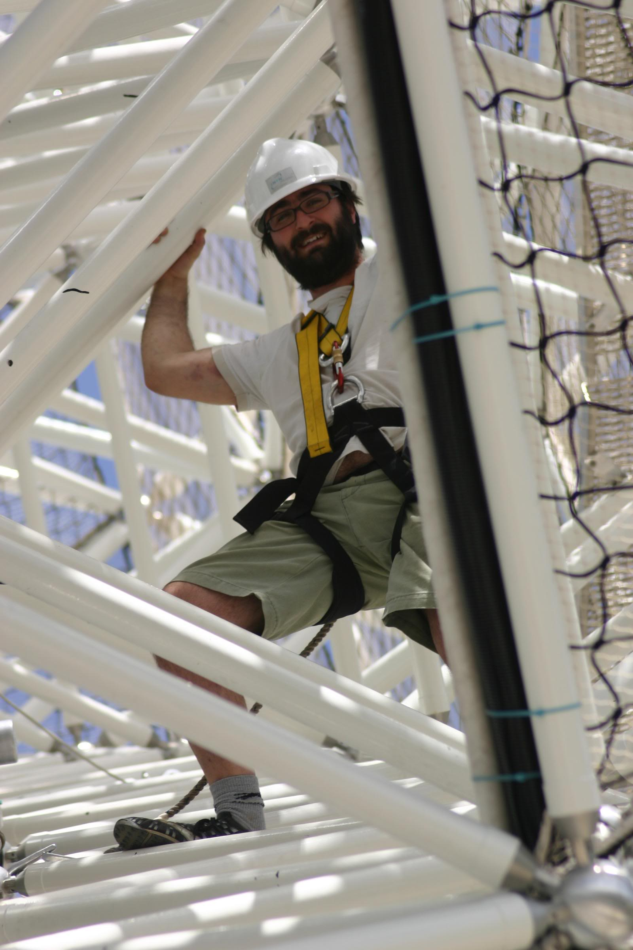
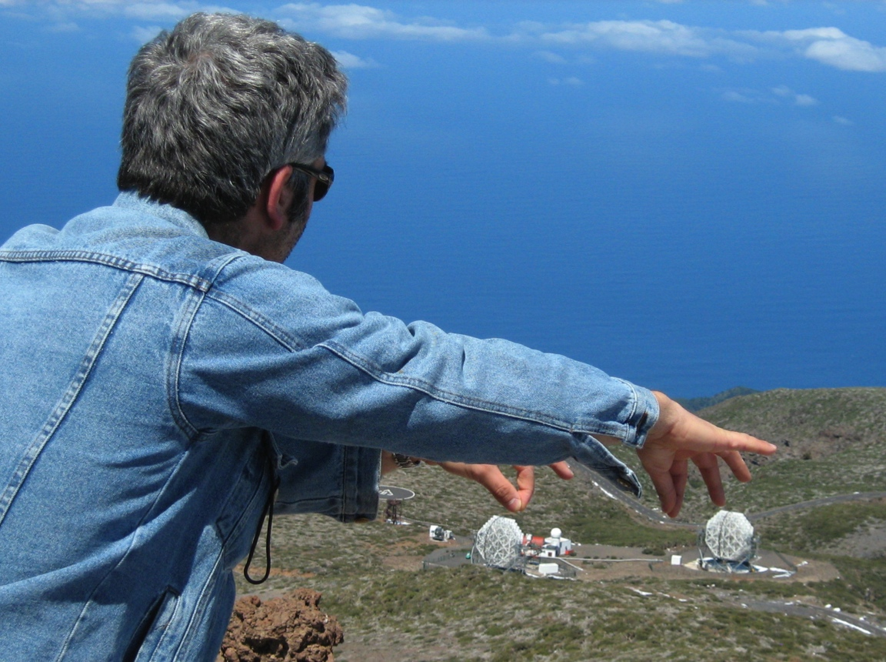
Introduction
We do both
climb or marbles game with MAGIC

Slide 7
The structures
Mostly of the Cherenkov telescopes look like these

Slide 8
The structures
Mostly of the Cherenkov telescopes look like these

Slide 9
The structures
Mostly of the Cherenkov telescopes look like these
They are very large light collectors

Slide 10
The structures
Mostly of the Cherenkov telescopes look like these
They are very large light collectors
camera
mirrors
structure

Slide 11
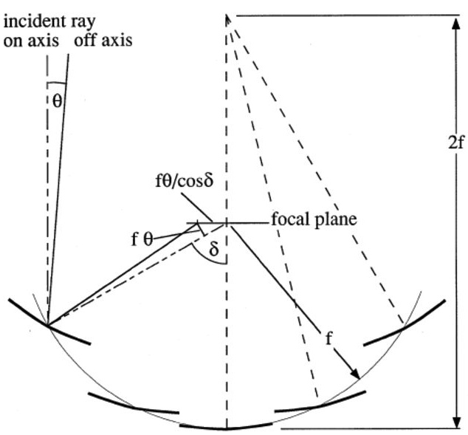
The Davies-Cotton layout
Originally (1957) proposed for solar concentrators.
Single reflection.
Discontinuous optical surface.
Many identical spherical mirrors accommodated on a spherical structure with the curvature being half of the mirrors one.
Better performances for off-axis rays when compared to a spherical or parabolic layout.

Slide 12
The structures
Alt-Az mount
alt: −20° ÷ 100°
az: ±270°

Slide 13
The structures
Stow/safety position
(below) Horizon pointing, toward North
Pros:
easy access to camera body;
no Sunlight concentration;
no accumulation of snow
Cons:
wind effect
S
N
S
N

Slide 14
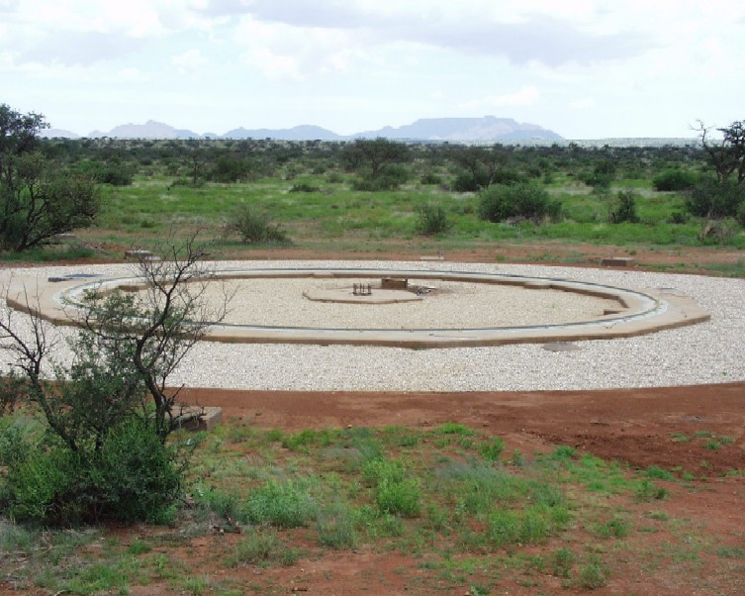
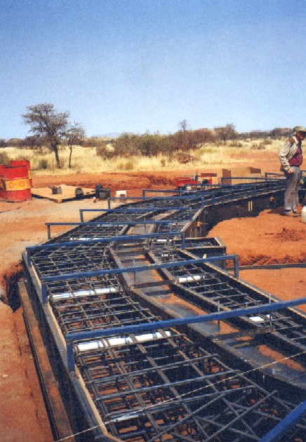
The structures
Foundation

Slide 15
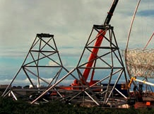
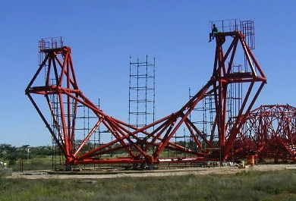
The structures
Aluminum tubes
Elevation Fork
Stainless still tubes

Slide 16
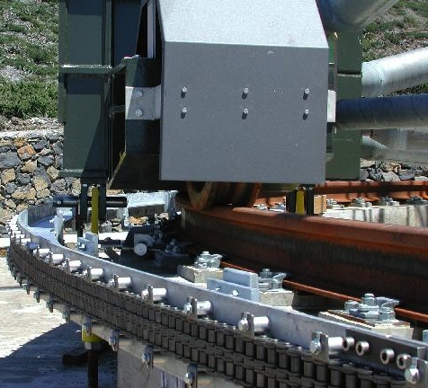
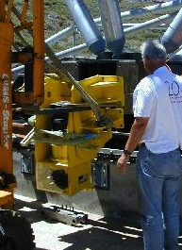
The structures
Bogies, wheels and rails… like trains!
Azimuth drive system
Azimuth motor

Slide 17
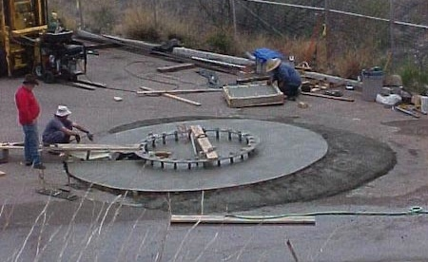
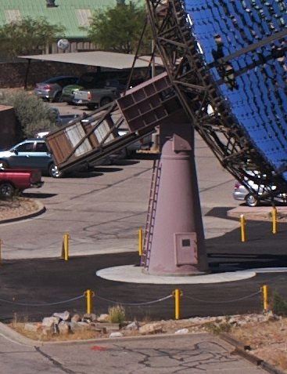
The structures
Elevation drive system
Counterweights
Foundation
Pillar
Azimuth drive system

Slide 18
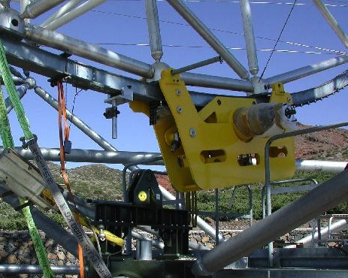
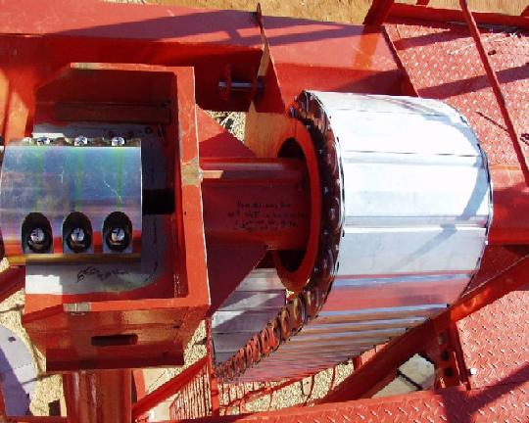
The structures
Elevation drive system

Slide 19
The structures
Extract from “CTA Design Study”
arXiv/1008.3703

Slide 20
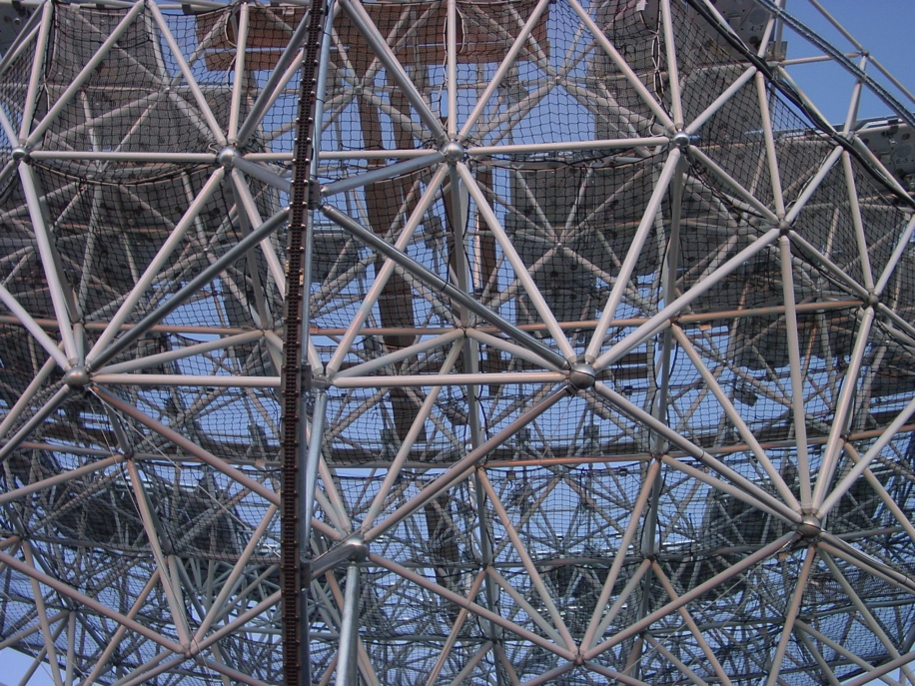
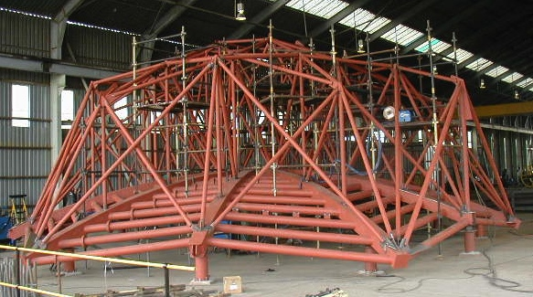
The structures
Lattice structure: carbon fiber
Dish structure
Lattice structure: stainless steel

Slide 21
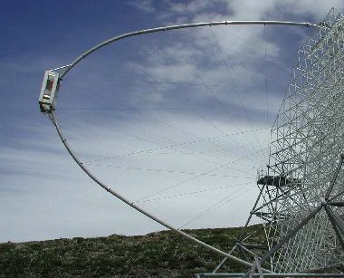
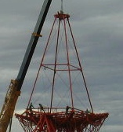
The structures
Arch
Camera mast
Quadrupod

Slide 22
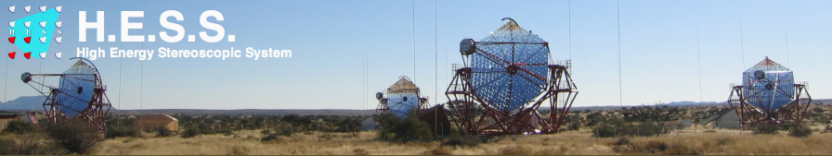
Current experiments
Layout: array with 4 telescopes
Mirror area: 4 × 108 m²
Site: The Khomas Highland of Namibia
Location: 23°16’18” S, 16°30’00” E at 1800 m asl
Operating since: 2002 (array in 2004)
Website: http://www.mpi-hd.mpg.de/hfm/HESS/

Slide 23
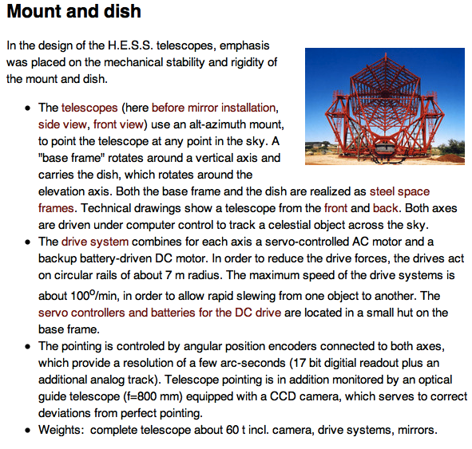
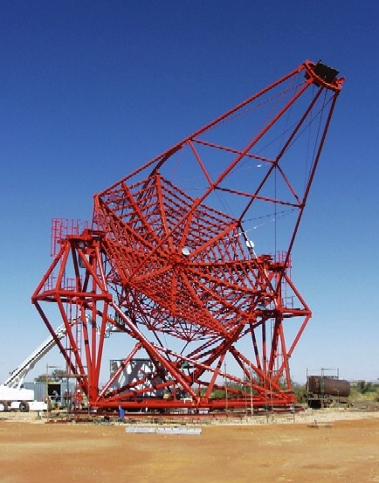
Current experiments
Extract from http://www.mpi-hd.mpg.de/hfm/HESS/

Slide 24
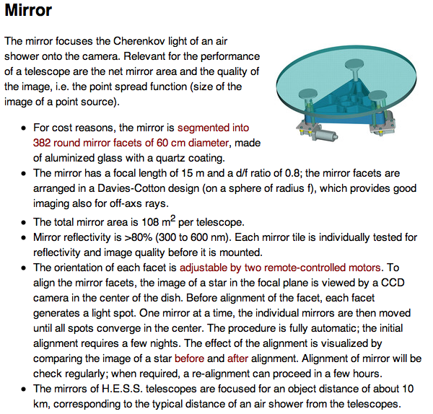
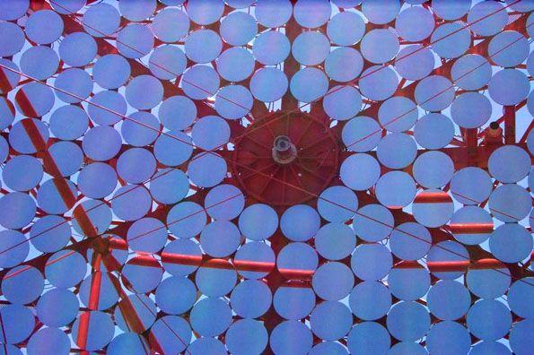
Current experiments
Extract from http://www.mpi-hd.mpg.de/hfm/HESS/

Slide 25
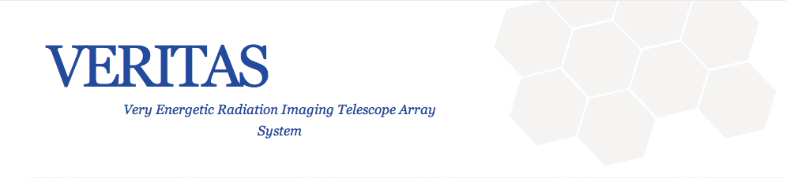
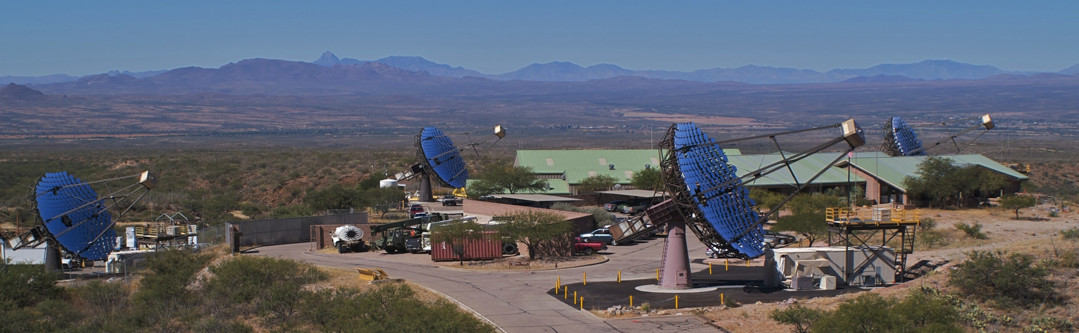
Current experiments
Layout: array with 4 telescopes
Mirror area: 4 × 110 m²
Site: Coronado National Forest, Arizona
Location: +31°40’30” N, -110°57’8” E at 1268 m asl
Operating since: 2003 (array in 2007)
Website: http://veritas.sao.arizona.edu/index.php

Slide 26
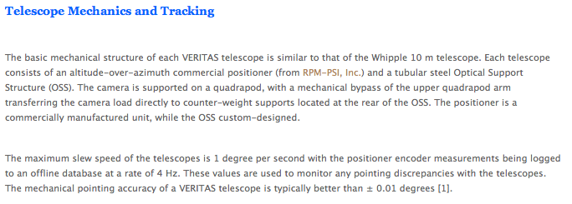
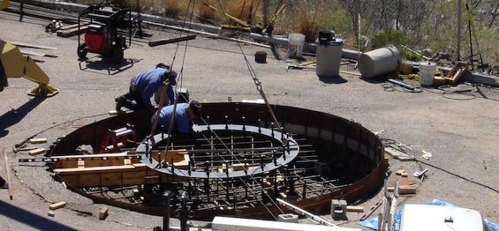
Current experiments
Extract from http://veritas.sao.arizona.edu/index.php

Slide 27
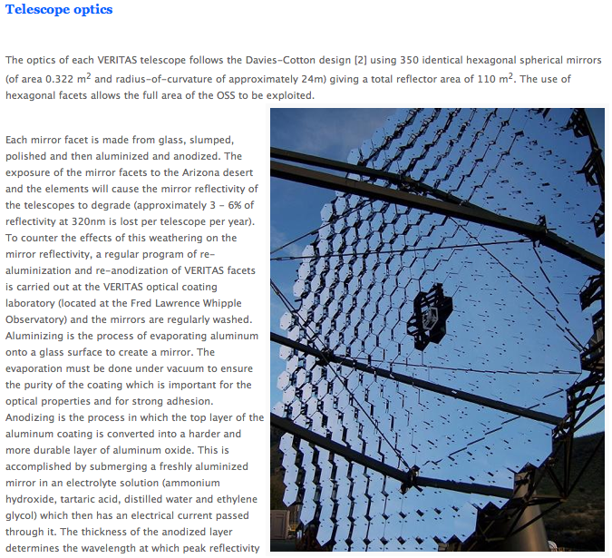
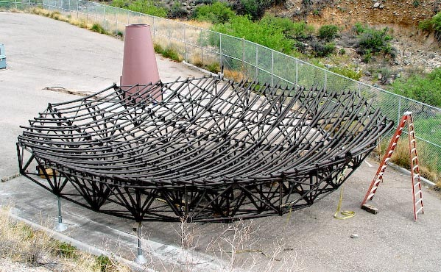
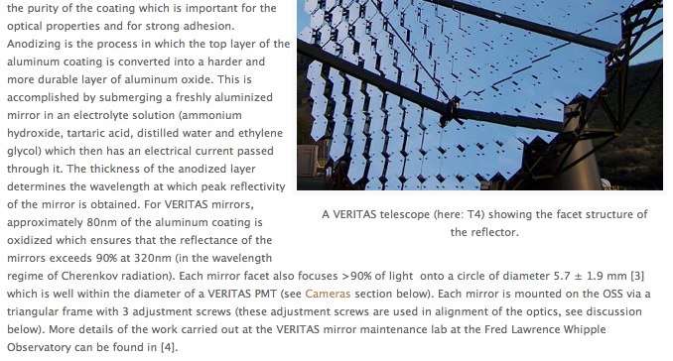
Current experiments
Extract from http://veritas.sao.arizona.edu/index.php

Slide 28

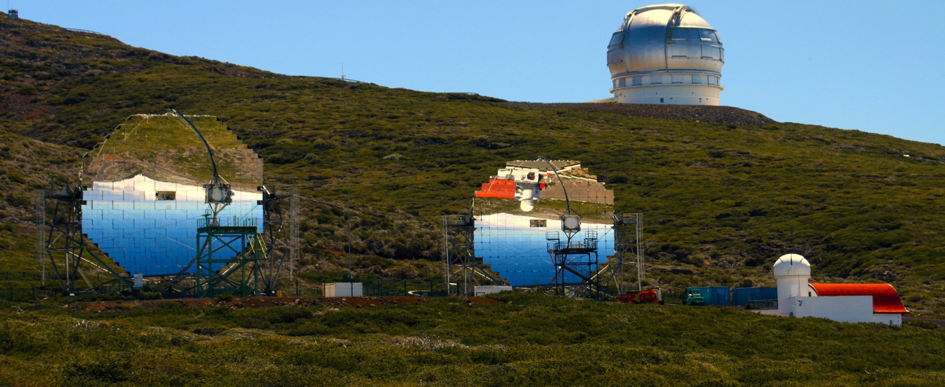

Current experiments
Layout: array with 2 telescopes
Mirror area: 2 × 236 m²
Site: Roque de los Muchachos, La Palma, Canary Islands
Location: +28°45’42” N, -17°53’25” E at 2200 m asl
Operating since: 2004 (array in 2009)
Website: http://magic.mppmu.mpg.de/

Slide 29
Current experiments
Extract from PhD Thesis, Michele Doro

Slide 30
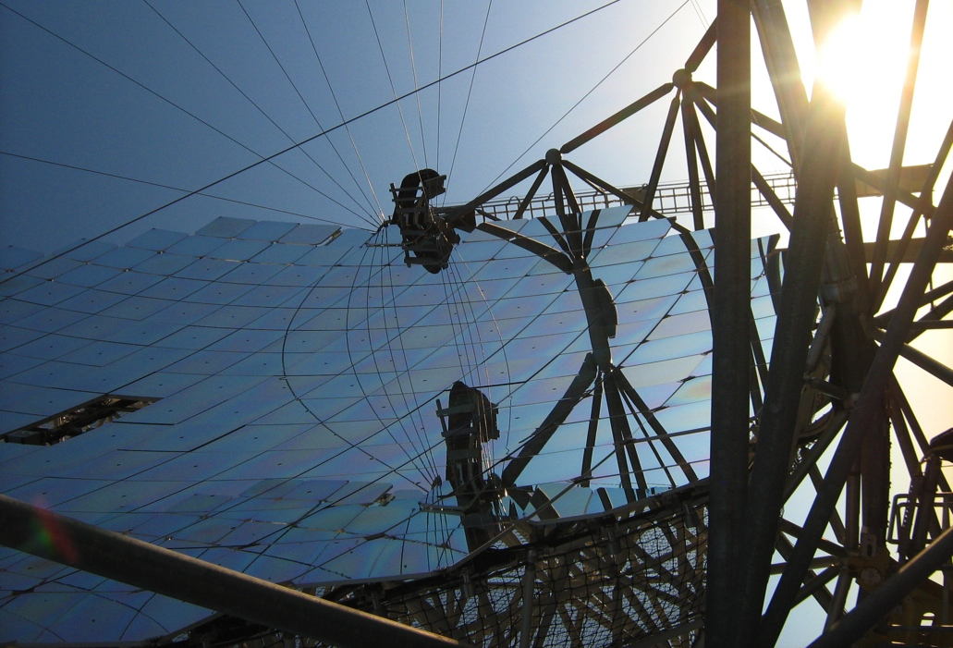
Current experiments
Extract from PhD Thesis, Michele Doro

Slide 31
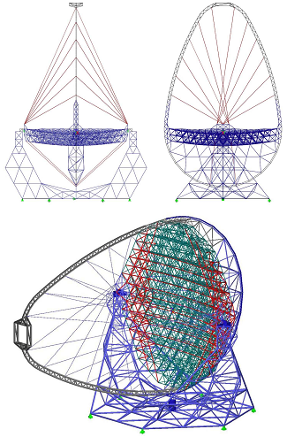
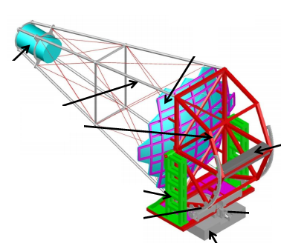
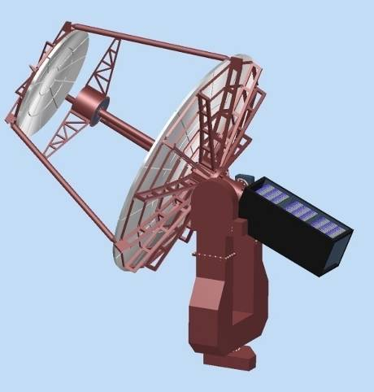
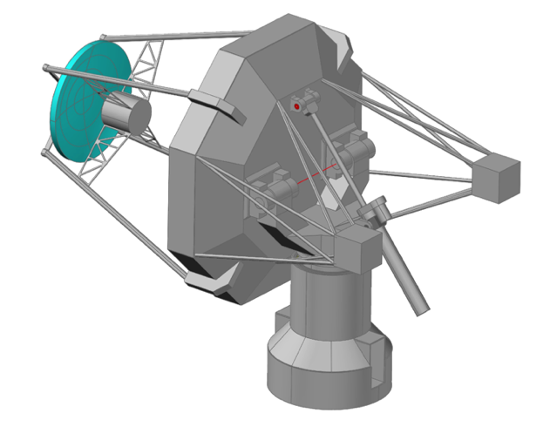
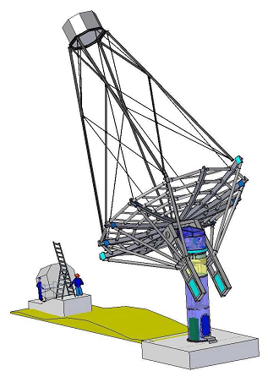
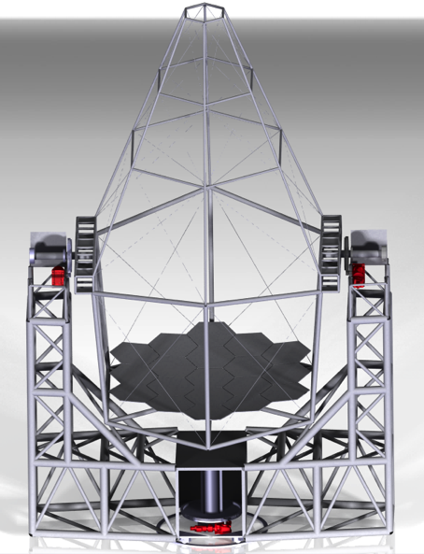
The solutions adopted for CTA
SSTs
LST
MST

Slide 32
The mirrors
Parameter | Min Value | Max Value
Temperature range | -25°C | +60°C
Winds speed | 0 km/h | 200 km/h
Humidity | 0% | 100%
Snow, ice
Hail
Sandblasting
UV radiation

Slide 33
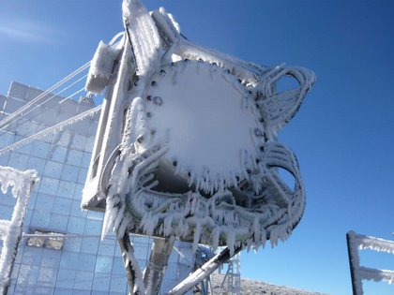
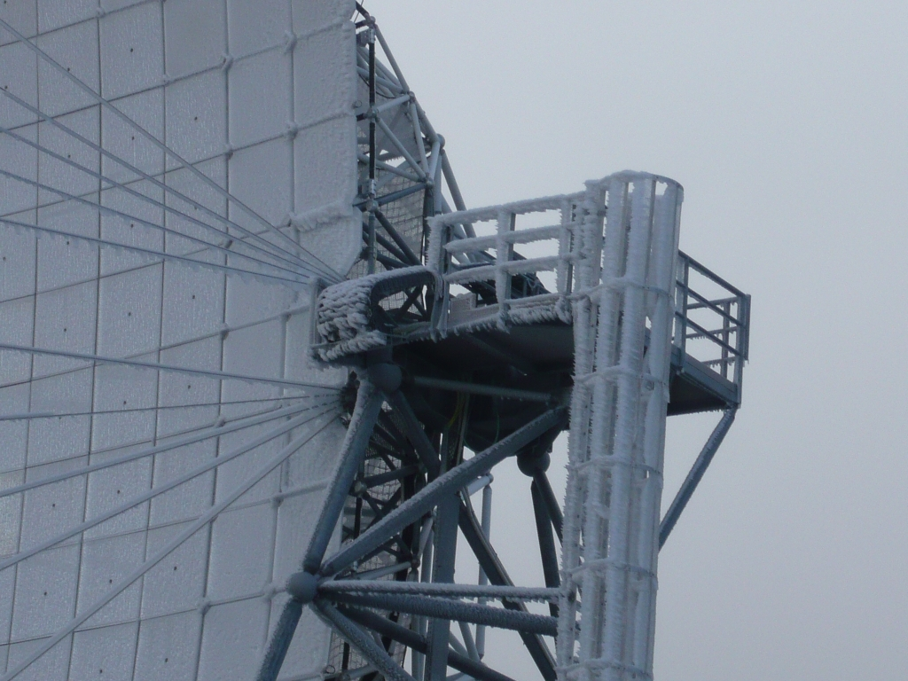
The mirrors

Slide 34
The mirrors
Parameter | Cherenkov | Optical
Optical quality | few arcmin | sub-arcsec
Areal density | 20 kg/m² | 70 kg/m²
Cost | 2 k€/m² | 100-300 k€/m²

Slide 35
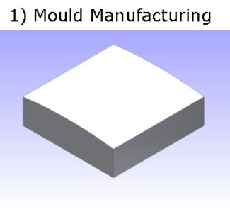
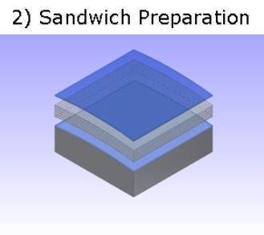
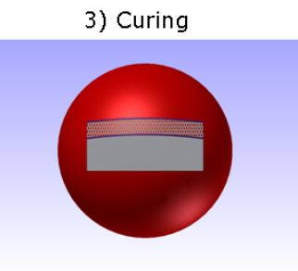
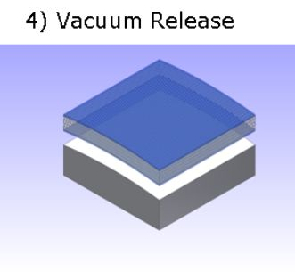
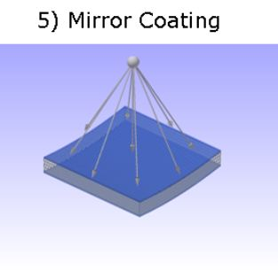
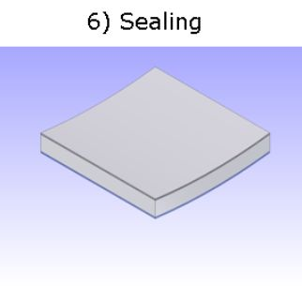

The cold glass slumping technique
Front glass sheet
Back glass sheet
Al honeycomb core
PVD coating
Al + SiO₂

Slide 36
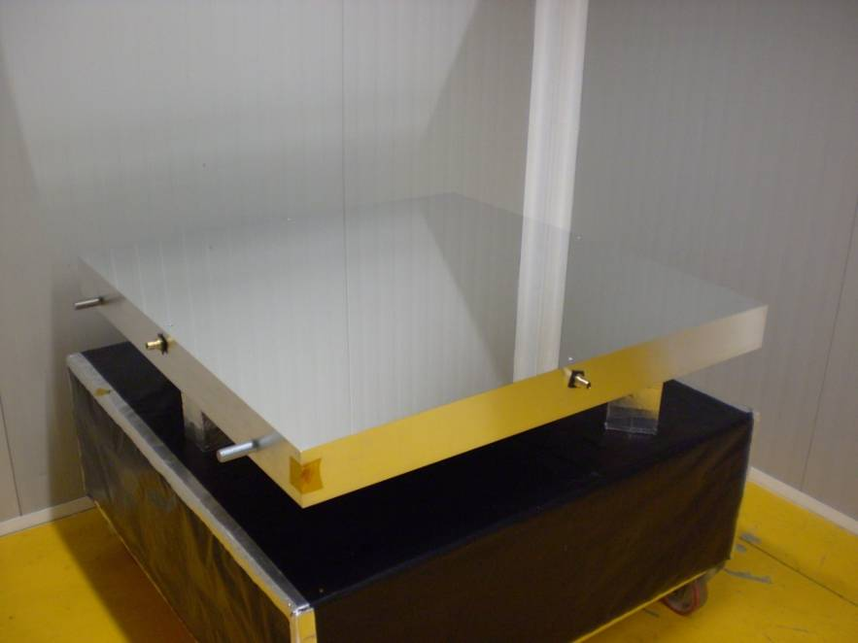

The cold glass slumping technique
Aluminum master 1040 x 1040 mm
Points: 392
P-V: 21.5 μm
RMS: 4.6 μm

Slide 37



The cold glass slumping technique

Slide 38


The cold glass slumping technique

Slide 39
The cold glass slumping technique

Slide 40


The cold glass slumping technique
PVD coating: Al + SiO₂

Slide 41


The cold glass slumping technique

Slide 42
The cold glass slumping technique

Slide 43


