Slide 1
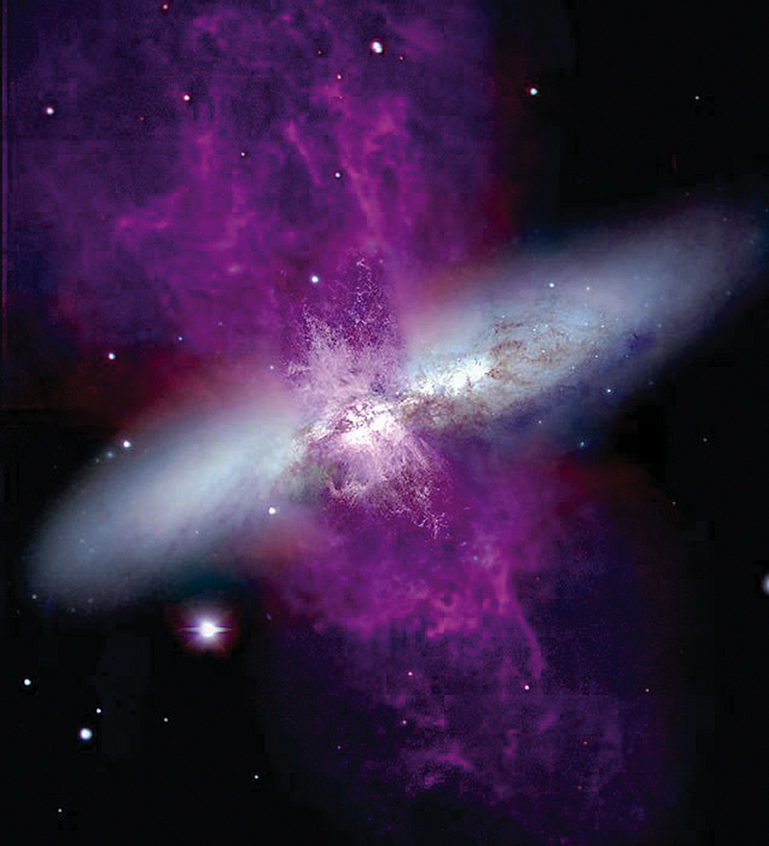
Gamma Rays from Star Forming Galaxies and Dark Matter
Massimo Persic
INAF+INFN Trieste

Slide 2
Particle Acceleration
Non-Thermal plasma: T_{ion} ≠Τ_{electron}
f(v) of either species non-Maxwell Boltzmann

Slide 3
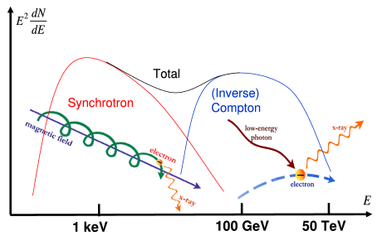
Radiation Processes
synchrotron
bremsstrahlung
Inverse Compton

Slide 4
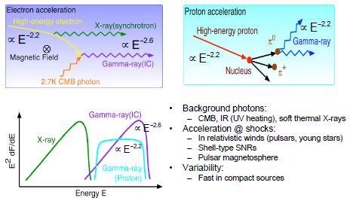

Slide 5
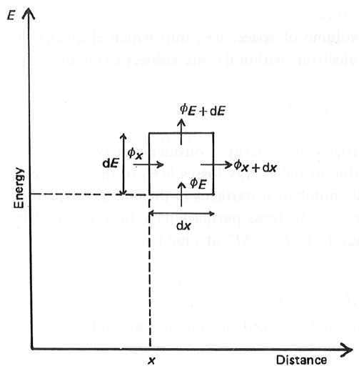
Diffusion-Loss Equation
energy
gains /
losses
diffusion

Slide 6
energy
gains /
losses
diffusion
rate of particles production
per unit volume of coord space
by definition:
energy loss
for particles
of energy E

Slide 7
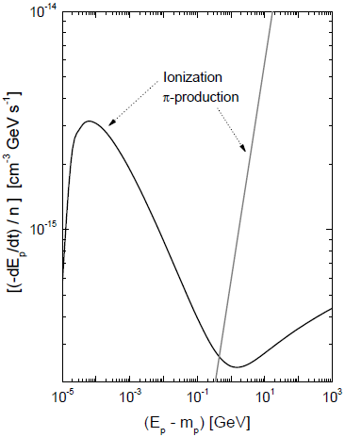
Energy loss processes: protons
l Ionization losses
{
10⁻¹⁴ n_{p} (1-Γ_{p}²)^{-1/2} [10.9 + 2 ln Γ_{p} + ln (1-Γ_{p}⁻²) + (1-Γ_{p}⁻²)] s⁻¹
dΓ_{p}
≅
5 × 10⁻¹⁵ n_{p} [26.73 + 3 ln(Γ_{p})] s⁻¹
Γ_{p} > 2000
l Pion production
dΓ_{p}
≅ 3.7 × 10⁻¹³ n_{p} (Γ_{p}-1)
Γ_{p} > 2.38 (→ 1.22 GeV)
(Γ_{p}-1)m_{p}c²

Slide 8
Energy loss processes: electrons
b(γ) = b_{Coul}(γ) + b_{syn}(γ) + b_{IC}(γ) + b_{brem}(γ) + b_{AW}(γ)
l Coulomb interactions with thermal electrons
l synchrotron radiation
l Inverse Compton (IC) scattering
… for U_{r}=4 10⁻¹³ erg cm⁻³
r
l bremsstahlung radiation
l Scattering by Alfvèn waves
b_{AW} = -B (4πρ) ^{-1/2} /L γ = 3 ×10⁻¹⁶ (B/μG) n_{e} (L/0.3 kpc)⁻¹ γ s⁻¹

Slide 9
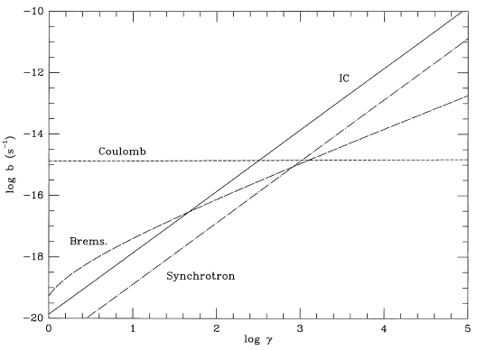
Coulomb
Starburst galaxy:
n_{e} = 100 cm⁻³
B = 100 μG
z = 0
IC
AW
Brems
Synchrotron
Galaxy cluster:
n_{e} = 10⁻³ cm⁻³
B = 1 μG
z = 0

Slide 10
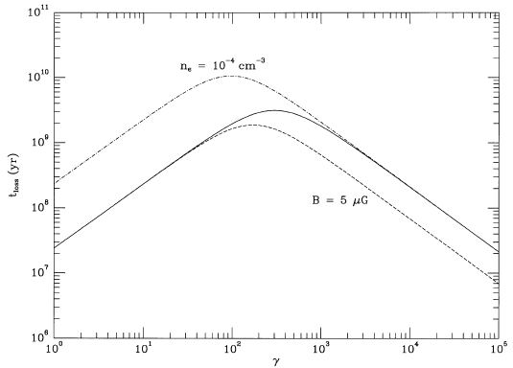
n_{e}=10⁻⁴, B=1 μG
n_{e}=10⁻³, B=1 μG
hjffyfkyfky
n_{e}=10⁻³, B=5 μG
Cooling time: t_{loss} = γ/b(γ)

Slide 11
HE Gamma Rays in Galaxies
MP, Rephaeli & Arieli 2008, A&A, 486, 143
Rephaeli, Arieli & MP 2010, MNRAS, 401, 473
MP & Rephaeli 2010, MNRAS, 403, 1569
l electron spectrum
N_{e}(γ) = N_{e,0} γ^{−q} γ₁≤γ ≤γ₂
l synchr. emissivity
F_{ν} = 5.67×10⁻²² (r_{s}³/d²) N_{e,0} a(q) B^{(q+1)/2} (ν/4×10⁺⁶)^{−(q−1)/2} erg/(s cm² Hz)
l electron spectrum: normalization, energy density
l particle/field energy density equipartition

Slide 12
l p/e energy density ratio
=
T₀ =
few keV
l p/e ratio
ð q=2.3 → κ=U_{p}/U_{e}≈15 N_{p}/N_{e}|_{>>1GeV} ≈ 1.3 ×10²
l equipartition magnetic field
l CRp energy density
U_{p} =
B²
8π (1+κ⁻¹)
primary/secondari
electron ratio ~ 0.5

Slide 13
M82 d=3.6 Mpc
r(SB)= 0.3 kpc
f_{1GHz} = 10 Jy
Persic, Rephaeli & Arieli 2008
A&A, 486, 143
Klein+ 1988
a_{r}=0.71 → q=2.42
ν_{SN} ~ 0.3 yr⁻¹
L_{8−1000μm} = 2.2×10⁴⁴ erg s ⁻¹
→ SFR ~10 M⊗yr⁻¹

Slide 14
VHE γ-ray emission
(… M82 cont’d)
Drury+
1994
analytical approx.
SB nucleus: r≤0.3 kpc
M_{H2} = 2×10⁸ M⊗
U_{p} = 200 eV cm⁻³
L_{>100GeV} =1.6×10³⁹ s⁻¹ ◊ F_{>100GeV} = 10⁻¹² cm⁻² s⁻¹
External disk: r>0.3 kpc
Σ(R) = Σ(0) e^{−R/R}d
Gas: flat, thin, exponential disk:
M_{g}=2.5×10⁹M⊗
Σ(0) = 7.5E+22 cm⁻²
U_{p} = 200 (R/R_{SB})⁻²
R_{d} = 0.82 kpc
L_{>100GeV} = 1.5×10⁴⁰ s⁻¹ → F_{>100GeV} = 10⁻¹¹ cm⁻² s⁻¹
Total flux: F_{>100GeV} = 1.1×10⁻¹¹ cm⁻² s⁻¹

Slide 15
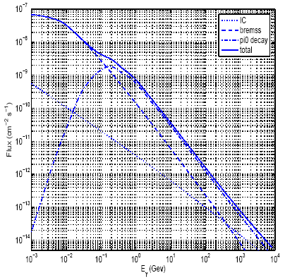
(… M82 cont’d)
numerical treatment
loss-propagation model
… same structure parameters
CR/field energy equip.
p/e theoretically assumed
injection part. spectrum: q=2
... interactively →
N_{e} ~ 10⁻⁴ cm⁻³
N_{p}/N_{e} (>>1 GeV) ~ 50,
B₀ ~ 180 μG
Γ_{pred} ~ 2.3
protons
electrons
F_{>100MeV} = E-8 cm⁻² s⁻¹
F_{>100GeV} = 2.5E-12 cm⁻² s⁻¹
≥1/2 sens. of MAGIC-II, VERITAS

Slide 16
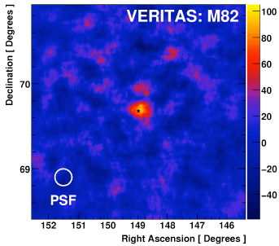
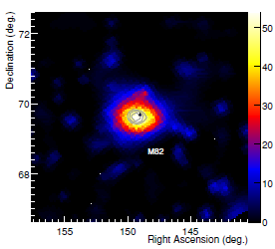
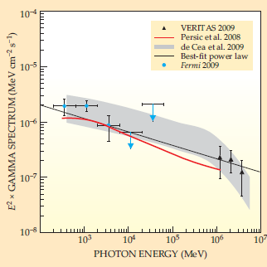
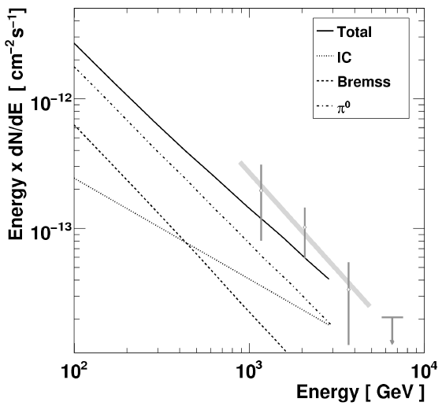
(… M82 cont’d)
M82
detection
Acciari et al. (VERITAS Collab.)
2009, Nature, 462, 770
Abdo et al. (LAT Collab.)
2010, ApJL, 709, L152
PRA 2008
Physics Today
January 2010

Slide 17
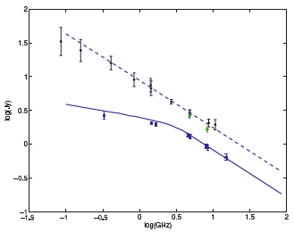
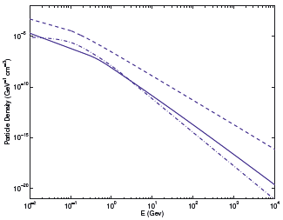
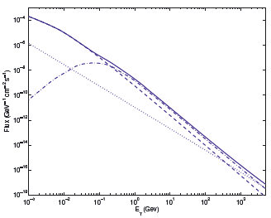
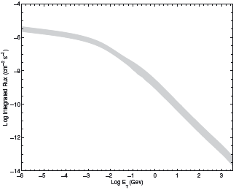
NGC 253
Rephaeli, Arieli & Persic 2010, MNRAS, 401, 473
protons
total
total
nucleus
electrons
total
differential
spectrum
integral
spectrum
π⁰ decay
IC
bremsstr

Slide 18
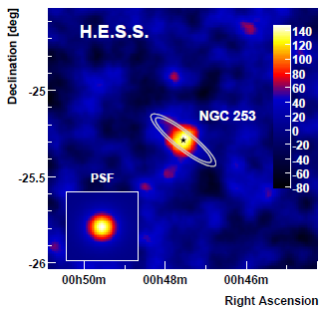
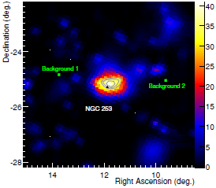
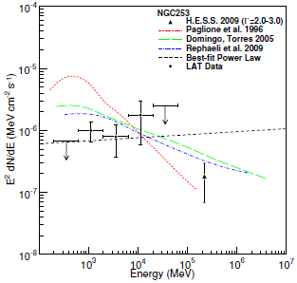
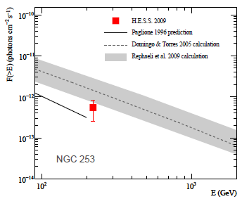
(… NGC253 cont’d)
NGC 253
detection
U_{p} ~ 150 eV cm⁻³
in SB nucleus
Acero et al. (HESS Collab.) 2009
Science, 326, 1080
Abdo et al. (LAT Collab.)
2010, ApJL, 709, L152

Slide 19
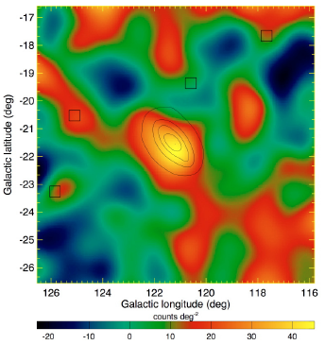
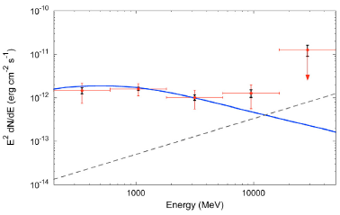
2. U_{p} from
γ-rays
M31 (Andromeda Galaxy)
Abdo et al. (LAT Collab.)
2010, A&A, 523, L2
MW model,
scaled
U_{p} ~ 0.36 eV cm⁻³

Slide 20
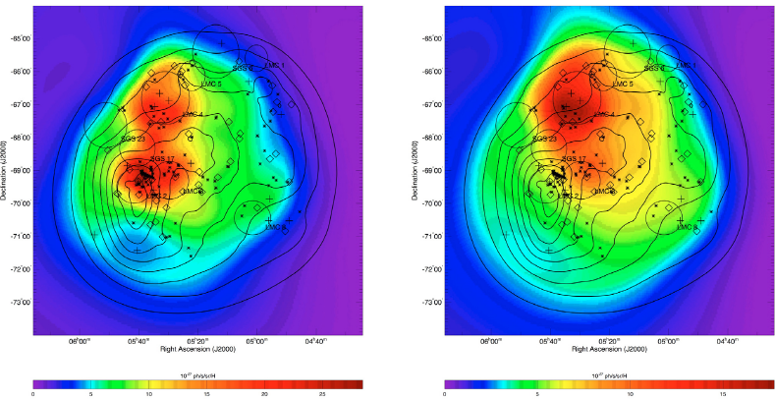
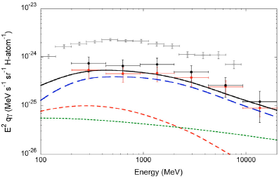
Large Magellanic Cloud (LMC)
MW
Abdo et al. (LAT Collab.)
2010, A&A, 512, 7
HI
H₂
U_{p} ~ 0.2-0.3 eV cm⁻³

Slide 21
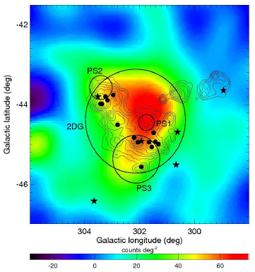
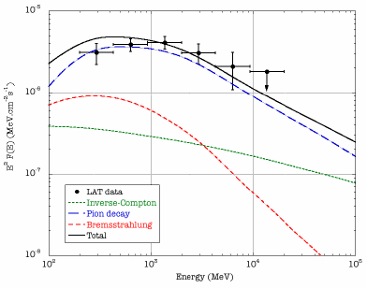
Small Magellanic Cloud (SMC)
Abdo et al. (LAT Collab.)
2010, A&A, 523, A46
U_{p} ~ 0.15 eV cm⁻³

Slide 22
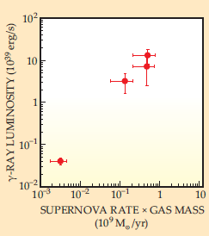
∝ ν_{SN} / r_{s}³
Adapted from:
l Abdo et al. (LAT Collab.)
2010, ApJL, 709, L152;
l Physics Today (Jan. 2010)
γ
γ
~ const,
galaxy-wide
M_{H}
M82
NGC253
MW
|
|
l
M31
HE emission from star-forming galaxies is mostly hadronic
LMC
|
SMC
l
l

Slide 23
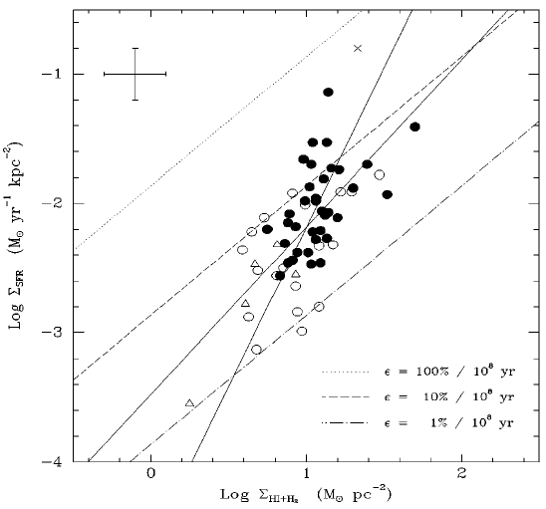
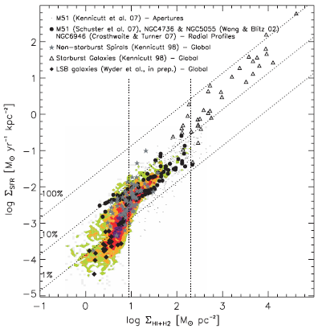
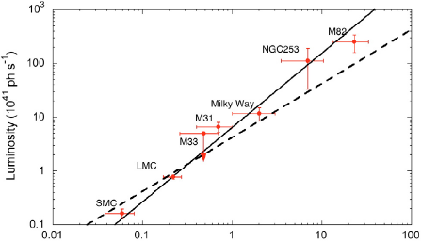
Kennicutt 1998
ARAA, 36, 189
2.5
Bigiel + 2008
AJ, 136, 2846
1.4
2.5
1.4
Schmidt-Kennicutt SF law:
Σ_{SFR} ∝ Σ_{HI+H2}^{α}
α~ 2.5
L_{γ} ∝ ν_{SN} M_{H} ∝
SFR M_{H} ∝
SFR^{(1+1/α)} = SFR^{1.4}
Abdo et al. (LAT Collab.)
2010, A&A, 523, L2

Slide 24
Measuring CR energy densities (U_{p}) in galaxies
Œ U_{p} from γ-ray emission:
.
Lifetime for energy gain: τ₊ = E/E = (ΔE/E)⁻¹Δt = β⁻¹ Δt ~ 10⁵ yr
Residency lifetime: τ₋⁻¹ = τ_{out}⁻¹ + τ_{pp}⁻¹
M82: τ_{out} = 3×10⁴ yr
M82: τ_{pp} = 2×10⁵ yr
Starburst lifetime: τ_{SB} ~ τ_{dyn} ~ 10⁸ yr
τ₊ ~ τ₋ ~ 10⁵ yr << τ_{SB}
Balance of gains vs losses achieved during SB
Equilibrium: min-energy confuguration → CR vs B equipartition
p/e ratio →  U_{p} from (radio synchrotron em. of) CRe
Ž U_{p} from SN rate & residency time: U_{p} ∝ ν_{SN} τ₋

Slide 25
Arp 220 → U_{p} ≈ 475 eV cm⁻³ radio
NGC 253 → 125 radio, γ
M 82 → 111 radio, γ
Milky Way → 1 …
M31 → 0.35 γ
LMC → 0.25 γ
SMC → 0.15 γ
U_{p} from supernovae
v massive star formation → SN
v SNR → Fermi-I mechanism → CR
v CR – SN relation (Ginzburg & Syrovatskii 1964)
Milky Way
normalization
observed
observed
U_{p} ~ ¼ (ν_{SN} τ₋) (η E_{ej}) r_{s}⁻³

Slide 26
Arp 220 → U_{p} ≈ 476 eV cm⁻³
NGC 253 → 125
M 82 → 111
Milky Way → 1
M31 → 0.35
LMC → 0.25
SMC → 0.15
obs’d
η ≈ 5%
obs’d
SN rate
particle
accel. eff.
SB radius
U_{p} ~ ¼ (ν_{SN} τ₋) (η E_{ej}) r_{s}⁻³
protons’
lifetime
E_{ej} ≈ 10⁵¹erg
kin. energy
of SN ejecta
(σ_{pp} cn_{p} )⁻¹ ~ 2 × 10⁷ n_{p} ⁻¹ yr
τ_ ≈
3 × 10⁴ (r_{s}/0.3 kpc) (v_{out}/2500 km s⁻¹)⁻¹ yr
pp collisions
advection
Arp 220
NGC 253
M 82
MW
M31
LMC
SMC
515 eV cm⁻³
77 eV cm⁻³
95 eV cm⁻³
1.8 eV cm⁻³
0.7 eV cm⁻³
0.2 eV cm⁻³
1.0 eV cm⁻³
3.50 yr⁻¹
0.12 yr⁻¹
0.25 yr⁻¹
0.02 yr⁻¹
0.01 yr⁻¹
2 E-3 yr⁻¹
1 E-3 yr⁻¹
9.0E+3 yr adv
2.0E+4 yr adv
2.6E+3 yr adv
5.0E+6 yr pp
2.0E+7 yr pp
1.0E+7 yr pp
4.0E+7 yr pp
0.25 kpc
0.20 kpc
0.26 kpc
2.4 kpc
4.2 kpc
3.0 kpc
2.1 kpc
V<sv
<bhsrs
Sngoug
n
if CRp advected by diffusion v_{diff}=100 km/s → U_{p}=0.15 eV/cm³

Slide 27
CONCLUSIONS on CRs
U_{p} can be measured from:
i) γ-ray emission (directly)
ii) radio synchrotron emission (indirectly),
assuming p/e ratio, part./field equilibrium.
iii) SN rates and CRp lifetimes.
Starbursts: U_{p} ~ O(100) eV cm⁻³
Quiet SFGs: U_{p} ~ O(1) eV cm⁻³
Universal(?) acceleration efficiency of SN.
Fermi I acceleration at work (NR strong shock).
Particles/field equipartition in place.
→ radio data to study CRs in high-z SFGs
Happy ending?

Slide 28
1. Galactic Center
Targets for DM search
Requirements:
1. Not associated with known
conventional TeV sources
2. High DM density
3. Close by
4. Not extended
Distance ~ 7.5 kpc → OK
... but:
other γ-ray sources in the FOV,
i.e. SNR Sgr A East
→ plausible competing scenarios
2. Dwarf Sph galaxies
ok 1(?), 2, 3, 4

Slide 29
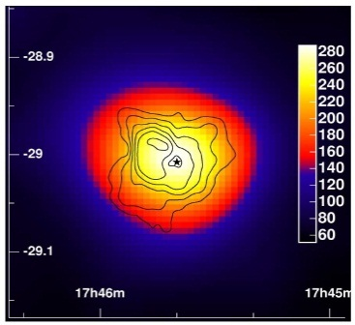
1. The Galactic Center
>1 TeV
VLA
Sgr A
no variability,
yr-min scale
MAGIC
Gal. Eq.
Detected: Cangaroo 2003
Confirmed: HESS 2004
Confirmed: MAGIC 2005
consistent with Sgr A* to 6’’
and slightly extended
Diffuse GP emission revealed
by subtracting strong sources
Correlation with molecular gas
CRs interacting with MCs
GC source coincident w. Sgr A*
MAGIC vs HESS
agreement !
slope = 2.2
Subtracted image
Contours of CS emission
(molecular tracer)
GC signal:
unlikely
to be DM
Notes:
In fact the gamma-ray emission is closely correlated to the distribution of molecular clouds in the central region (as traced by their CS line emission, shown here as white contours). This is the first correlation of its kind – indicating an origin of the gamma-ray emission via hadronic interactions of cosmic rays in the clouds. I have led the analysis of these data and written the paper which will appear in Nature this thursday.
Don't mention G0.9+0.1 or HESS J1745-30

Slide 30
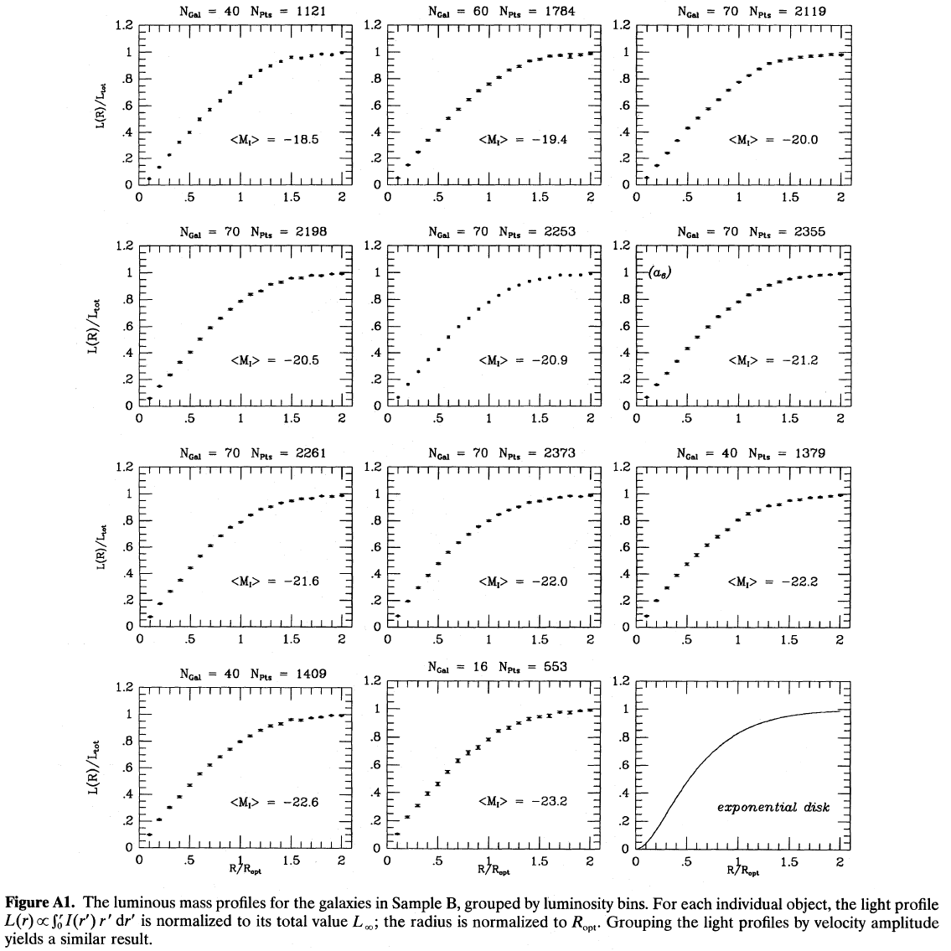
Some background
on galaxy structure ..
I(r) = I₀ exp(-r/R_{d})
same profile at
all luminosities!
1000 galaxies
Persic + 1996

Slide 31
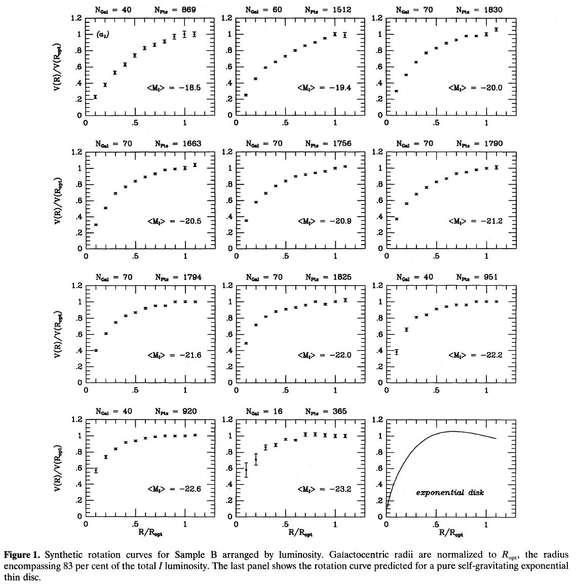
Rotation curves
are not self-similar
with luminosity!

Slide 32
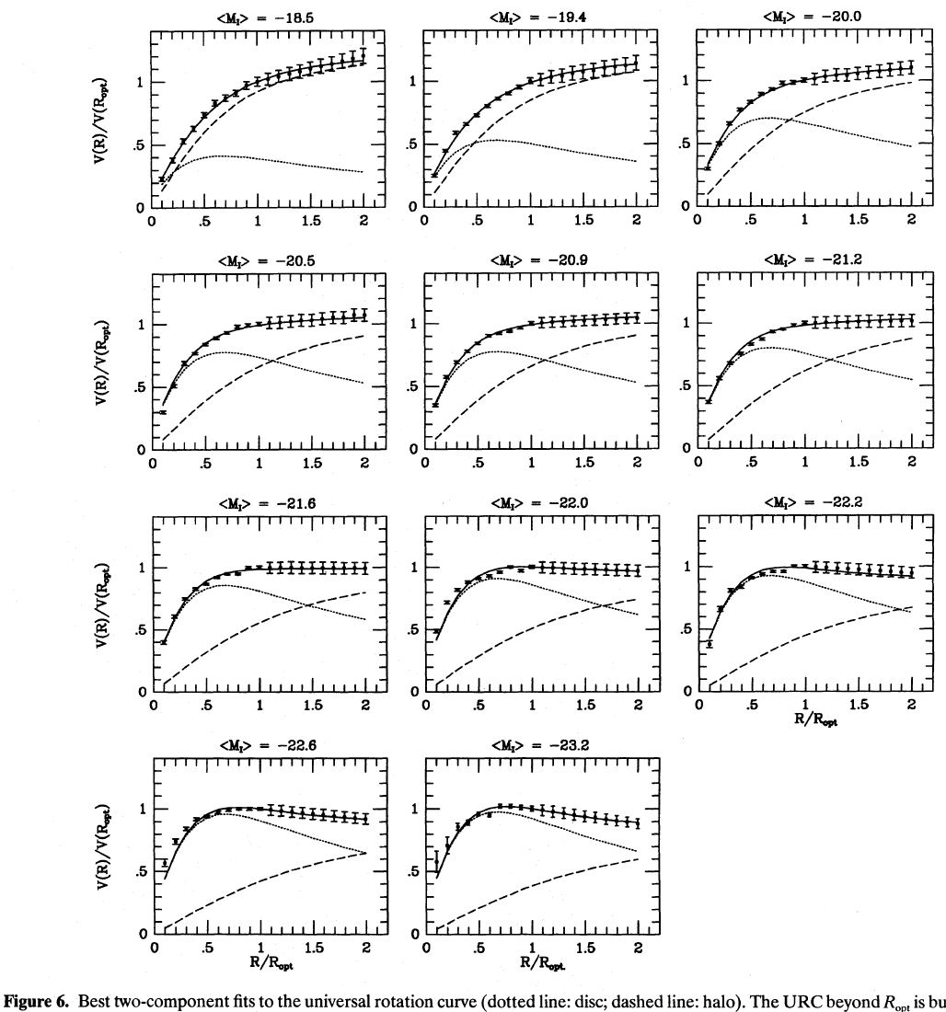
Smooth progression
of RC shape, and
disk/halo interplay,
with luminosity
Universal Rotation Curve
of spiral galaxies
lkugkfthjfftrd
blablablablabla

Slide 33
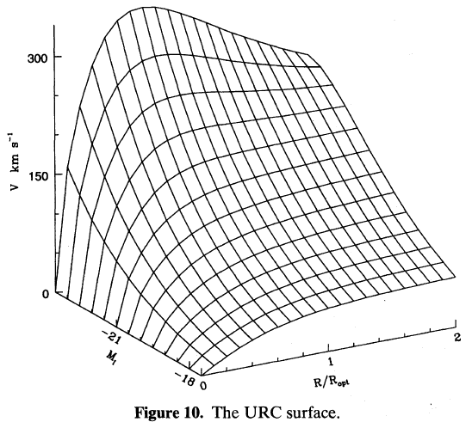
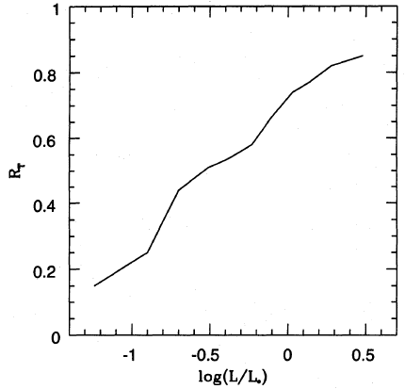
Tully-Fisher relation
R/R_{opt} when DM starts
to be dynamically felt
Rotation
curve

Slide 34
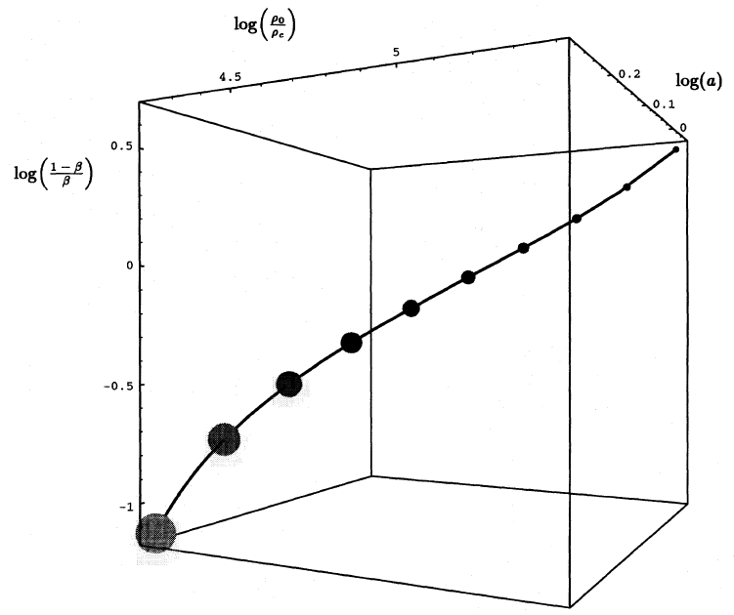

Slide 35
Whence these properties?
Bottom-up cosmology: small galaxies formed first, hence their density retains the cosmological density at the epch of their turnaround
(δρ/ρ ∼ 1.8).
Baryon infall: SF → SN expl. → winds → most of infalling baryons lost in small gals., but retained in bigger ones.
Smaller, denser gals. have little/no SF – bigger, less dense gals. do have gas and SF.

Slide 36
Small, nearby galaxies … or … large, faraway clusters?
Let’s start from signal from self-interacting DM decay
D⁻²
→ small distances best!
→ small guys win!
→ cosmology: dSph halos are best candidates for DM signal
→ astrophysics: dSph stellar pops. are most silent astroph bkgd

Slide 37
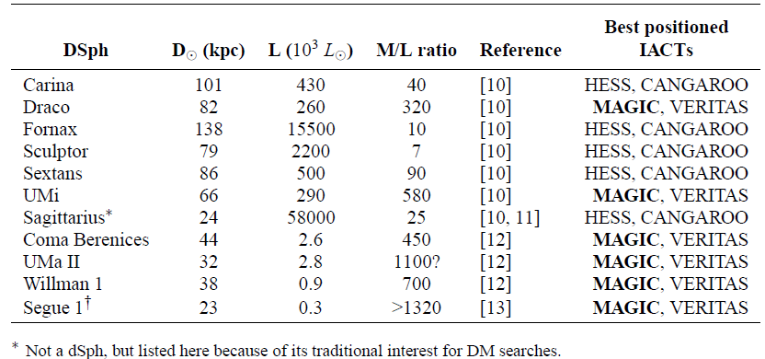
Dwarf Spheroidals: ideal DM candidates
Milky Way satellites → nearby
High M/L → DM dominated
Old stellar pop. → no ongoing SF
u

Slide 38
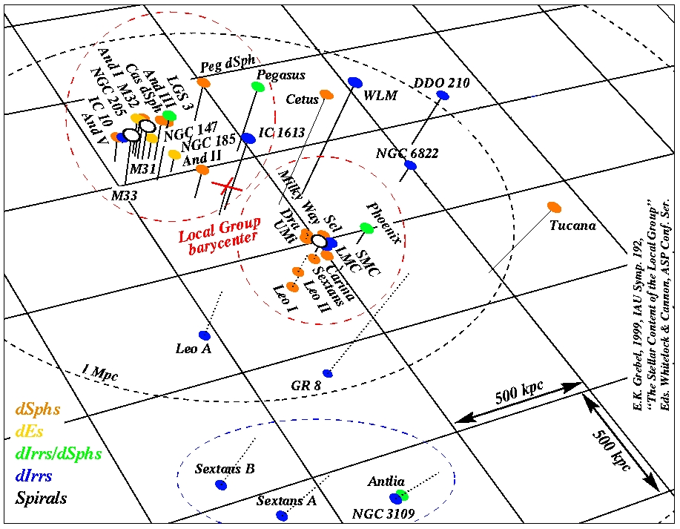

Slide 39
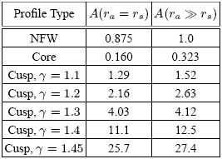
Example: Draco dSph modeling
d~80 kpc
Bergström &
Hooper 2006
total DM
annihil. rate
<σ_{A}v>, m_{χ}: WIMP annihil. cross section, mass
γ-ray flux
N_{γ}: γ-rays / annihil.
cusped
profile
upper limit
cored
profile
γ-ray flux
r_{s} = 7 – 0.2 kpc
ρ₀ = 10⁷ – 10⁹ M_{ž} kpc⁻³
ρ₀² r_{s}³ = 0.03 – 6 M_{ž}² kpc⁻³
part. phys
astrophys

Slide 40
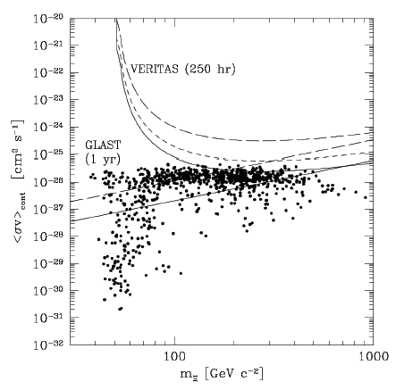
bb
t t
_
τ⁺τ⁻
_
min. cored
W⁺W⁻
ZZ
max. cusped
MAGIC
40-h exp.
Fermi LAT
1-yr exp.
Bergström & Hooper 2006
IACT neutralino detection:
<σ_{A}v> ≥ 10⁻²⁵ cm³s⁻¹
Stoehr + 2003

Slide 41
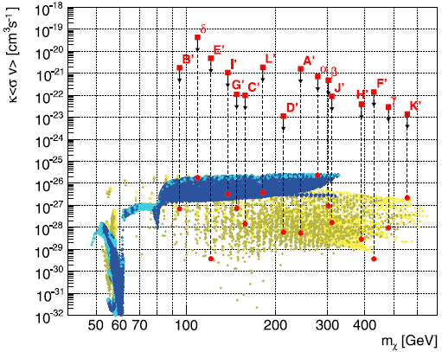
Draco dSph obs’d MAGIC Albert et al. 2008

Slide 42
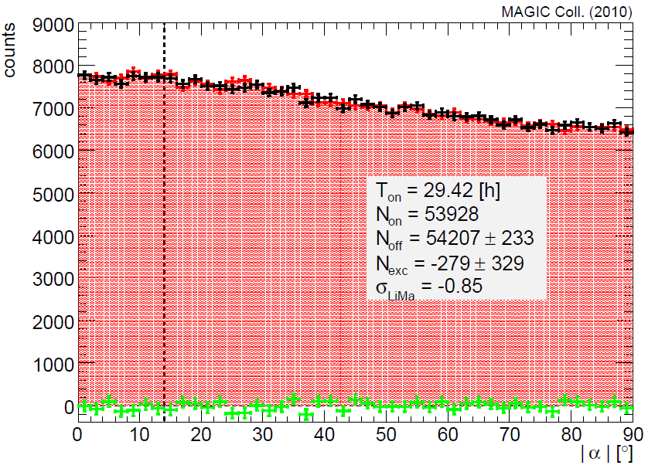
Segue-1 galaxy

Slide 43
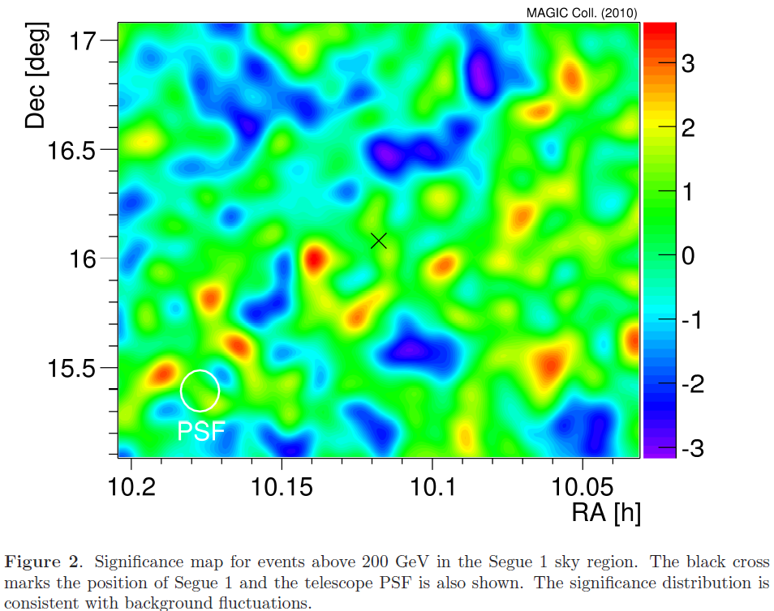

Slide 44
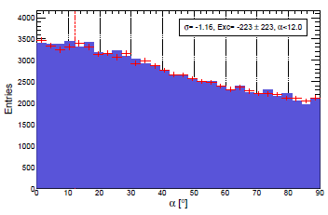
Wilman-I

Slide 45
Summary
Galaxies can produce VHE γ-rays, related to ongoing SF and DM decay
SF: γ emission detected from nearby starburst (M82, NGC253),
quiescent (M31, LMC, SMC), and SB/Seyfert-I (NGC1068, NGC4945)
galaxies.
CR energy densities: measured directly from γ-emission and
indirectly from radio emission, estimated from SR frequencies
→ results agree.
DM: no signal from MW center and from
(best candidate) MW satellite dSph galaxies.
→ hunt ongoing ...

